Slide 1


What an Individual Can Do, Does Not Mean the church Can Do It
Matthew 18:15-17

Slide 2
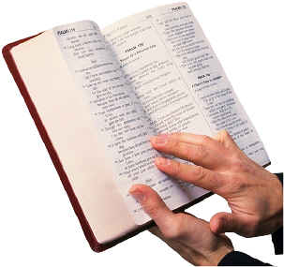
An Individual Christian / the church
Matthew 18:15-17
Two Individuals (15)
Two or Three Individuals (16)
The church (17)
Jesus has clearly made a distinction between an individual or individuals and the church.

Slide 3
the church
Greek: ekklēsia
Thayer:
1) a gathering of citizens called out from their homes into some public place, an assembly
1d1) an assembly of Christians gathered for worship in a religious meeting

Slide 4
the church
Greek: ekklēsia
Strong:
a calling out, that is, (concretely) a popular meeting, especially a religious congregation
(Jewish synagogue, or Christian community of members on earth or saints in heaven or
both): - assembly, church.

Slide 5
the church
Greek: ekklēsia
Vine’s: See Assembly or Congregation
1. ek out of, and klesis, a calling (kaleo to call) was used among the Greeks of a body of citizens gathered to discuss affairs of State (Acts 19:39)
2. religiously – “a company consisting of professed believers”

Slide 6
the church
Greek: ekklēsia
Summary
a gathering, a congregation, a company of the “called out”, believers or Christians (disciples of Christ) who have assembled for religious purposes.
Individual Christians have assembled together to function collectively.

Slide 7
the church
Greek: ekklēsia
For first of all, when you come together as a church, I hear that there are divisions among you, and in part I believe it. 1 Corinthians 11:18
The text clearly shows that individuals “come together as a church.”
If individual Christians “come together as a church” when the church disassembles/breaks up/disperses/dismisses the assembly they are no longer the church but individual Christians acting separately and not as the church.

Slide 8
An Individual Christian / the church
1 Timothy 5:16
An Individual Christian
  (Believing Man or Believing Woman)
“Do Not let the church be burdened”
Paul has clearly established that an individual Christian is not the church.

Slide 9
An Individual Christian / the church
1 Timothy 5:8
An Individual Male Christian is to Provide
  (“worse than an unbeliever”)
NO
Is a Christian’s providing for his own household the church acting?

Slide 10
An Individual Christian / the church
James 1:27
An Individual Christian in Context
  (James is not writing to the church (1))
NO
If you visit a widow or an orphan in their affliction or keep yourself unspotted from
the world, does that mean the church has done the same?

Slide 11
A Distinction is Made
Individual Christian
The church

Slide 12
A Distinction is Made
Individual Christian
The church
Any Widow
1 Timothy 5:4
Really Widows
1 Timothy 5:3,5,9-10
If any believing man or woman has widows, let them relieve them, and do not let the church be burdened, that it may relieve those who are really widows. 1 Timothy 5:16

Slide 13
A Distinction is Made
Individual Christian
The church
Any Widow
1 Timothy 5:4
Really Widows
1 Timothy 5:3,5,9-10
If any believing man or woman has widows, let them relieve them, and do not let the church be burdened, that it may relieve those who are really widows. 1 Timothy 5:16

Slide 14
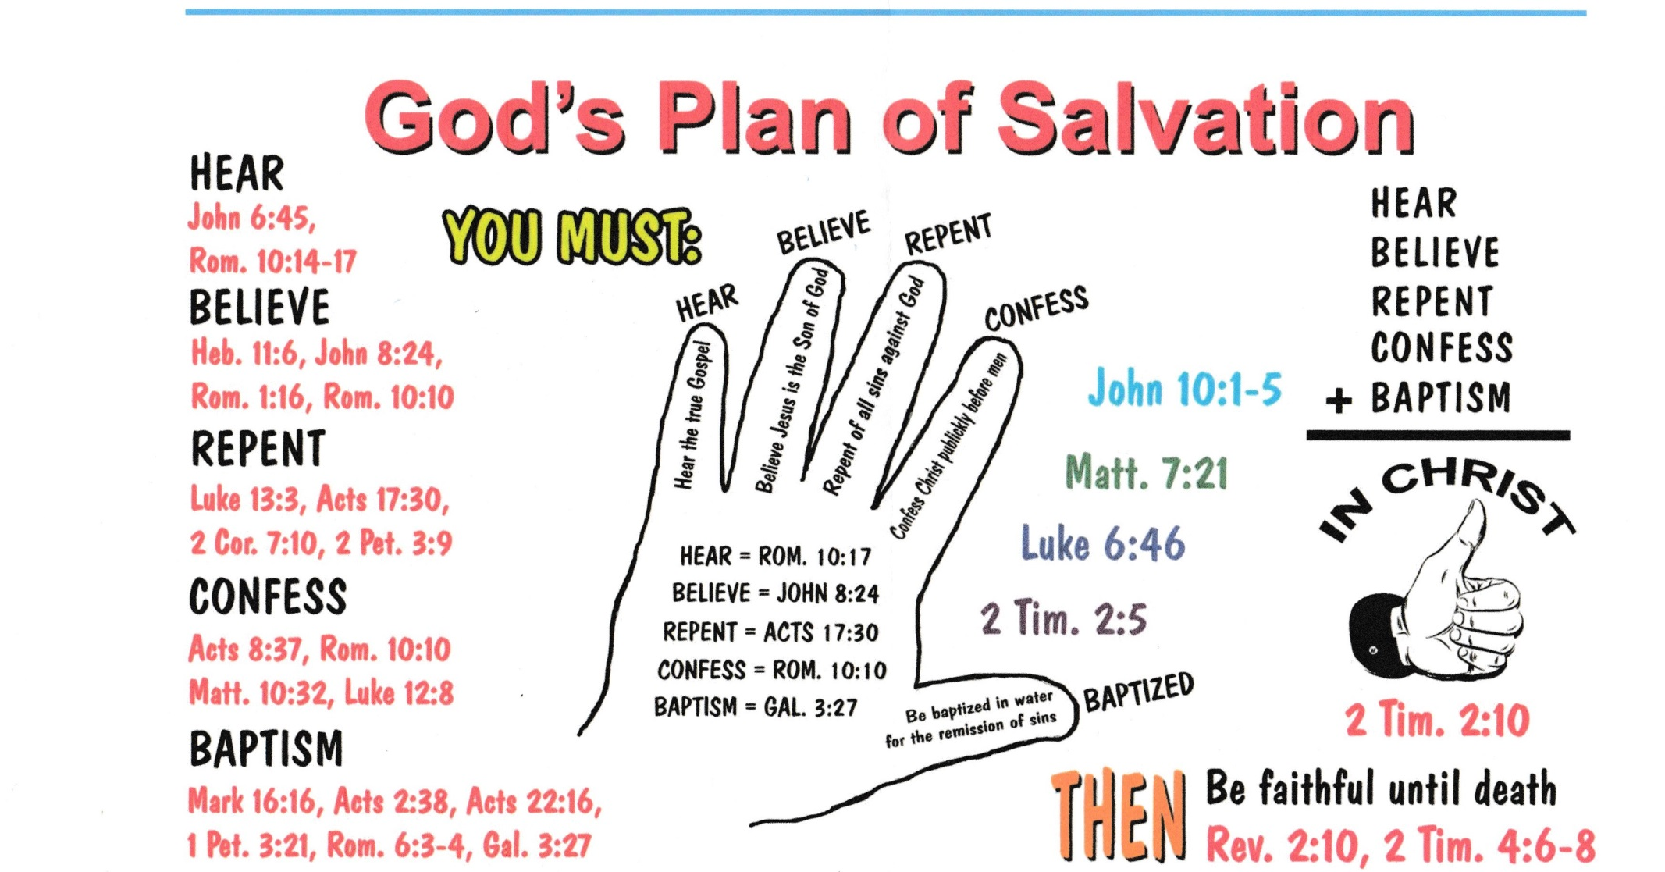

Slide 15

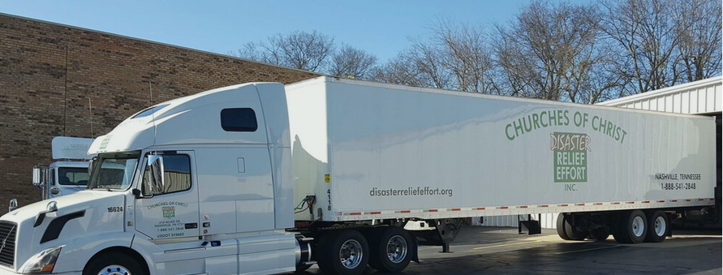

Slide 16
the church
Greek: ekklēsia
And if he shall neglect to hear them, tell it unto the church: but if he neglect to hear the church, let him be unto thee as an heathen man and a publican.
Matthew 18:17

