Slide 1
Apologetics-
Who Was Jesus
Tri-Cities
December 11, 2024

Slide 2
Outline
Introduction
Existence of God/Evidence in Other Cultures
Natural Revelation
Natural Revelation- Medicine
Did Jesus Live
What did Jesus claim

Slide 3

We are here
Ralph A. Clevenger

Slide 4
Lesson 1
The Study of Apologetics
The Bible is Not:
Science Book
Atlas
History Book
It is a Diary, a special Divine revelation
Accurate in other ways, but used the idioms of the day
  4 corners of the earth- Revelation 7:1
  Sun rising/setting- Ecclesiastes 1:5

Slide 5
"If you think strongly enough, you will be forced by science to believe in God."
-- William Thompson (Lord Kelvin) 1824-1907,
English Physicist. Inventor of the Kelvin temperature scale.
"If the Universe is a universe of thought, then its creation must have been an act of thought. Indeed the finiteness of time and space almost compel us, of themselves, to picture the creation as an act of thought."
-- Sir James Jeans, 1877-1946,
English Astronomer & Physicist

Slide 6
“For myself, faith begins with the realization that a supreme intelligence brought the universe into being and created man. It is incontrovertible that where there is a plan there is intelligence – an orderly, unfolding universe testifies to this truth.”
-- Arthur Compton, 1887 – 1954
Nobel prize winner in Physics

Slide 7
Reasons to Study Apologetics
Testing claims- OK to question
  Build faith
  Answer the unbeliever
  Not lose our young
“Reason and revelation are not opposed, nor reason and faith”
– H.W. Everest

Slide 8
Accepting Evidence
Weight of evidence
Clarity of how the evidence is presented
Honesty of the examiner
Logical ability of the hearer to evaluate
Background and prejudice of the hearer

Slide 9
Lesson 2
Common Ground
If ancient peoples had common beliefs in God, either:
  They evolved simultaneously
  They “borrowed” from each other
  They had a common ancestral knowledge
Has the God who created the gospel for all people, also prepared all people for the gospel?

Slide 10
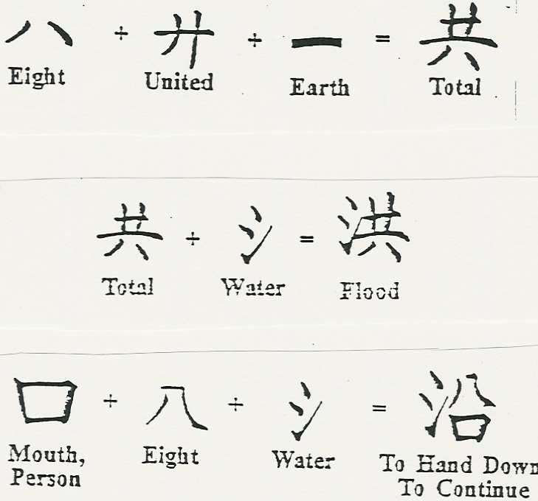
+
+
=
Person
Large Ship
Eight
Boat

Slide 11
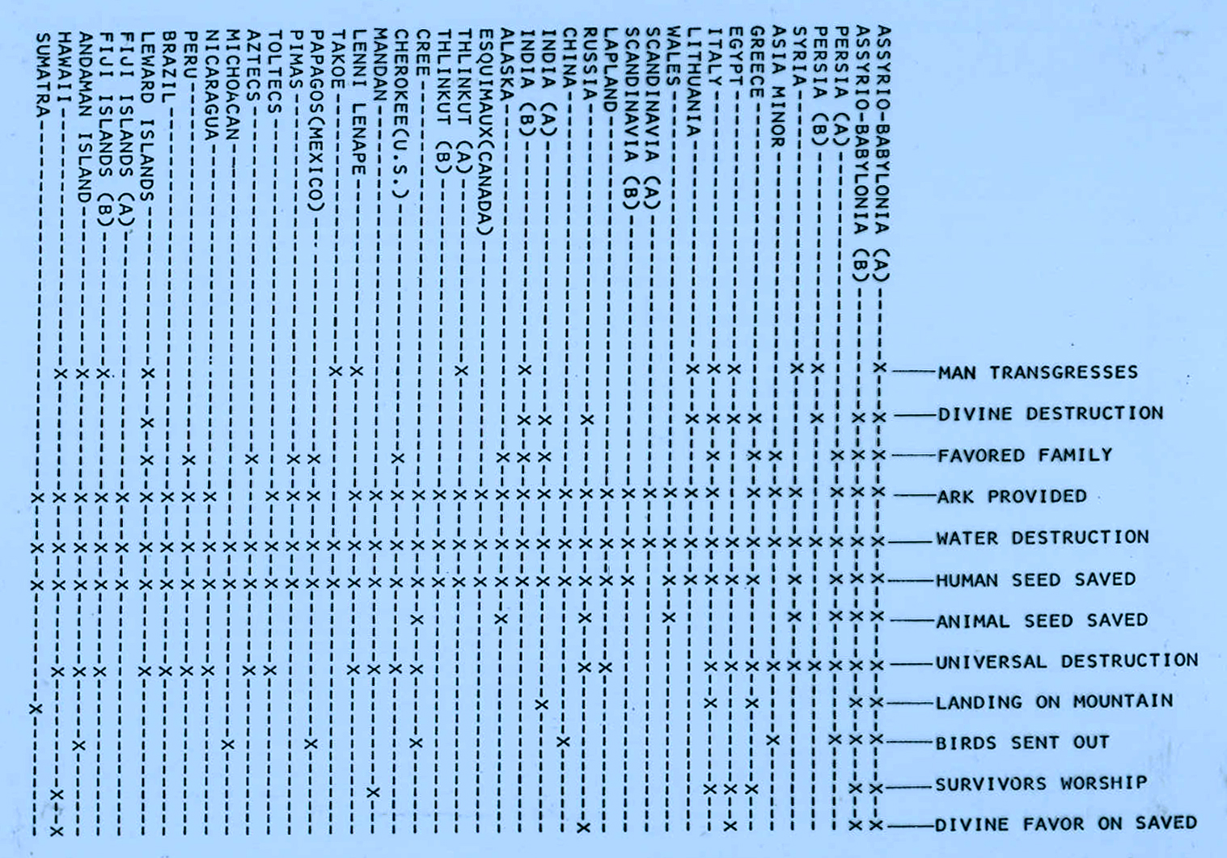
Gil Bremseth

Slide 12
Lesson 3
Our Universe
The heavens declare the glory of God; and the firmament shows His handiwork.
Psalm 19:1

Slide 13
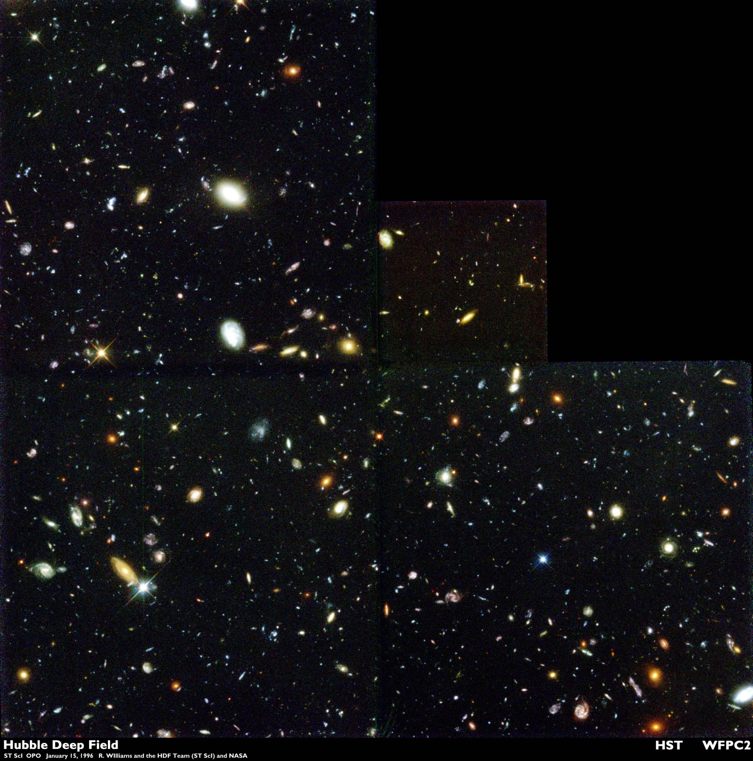
Hubblesite.org

Slide 14
O Lord, how many are Your works! In wisdom You have made them all. The earth is full of Your possessions.
Psalm 104:24

Slide 15
Lesson 4
The Human Body
“If it could be demonstrated that any complex organ existed which could not possibly have been formed by numerous successive, slight modifications, my theory would absolutely break down. But I can find no such case.”
Charles Darwin
The Origin of the Species

Slide 16
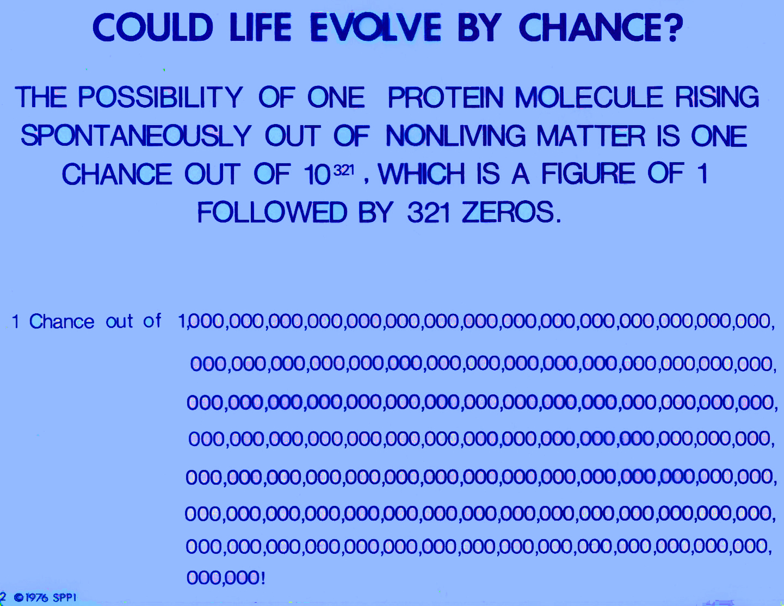
Gil Bremseth

Slide 17
Swiss physicist Charles Guye once estimated the probability of the random chance formation of a single simple protein of molecular weight 20,000 (too simple for life) and consisting of only 2 elements (compared to the usual 4 to 10) as such that if it had 500 trillion chances per second for any two of its components to randomly combine, it would take the number of years expressed by a 10 followed by 242 zeros to occur. (i.e. an impossibility!)
Dr. S. Pelletier, a University of Georgia chemist, has said that the initial chance formation of two or three protein molecules is "equivalent to admitting a miracle."

Slide 18
Lesson 5
Did Jesus live?
“What we have concerning Jesus actually is impressive…In all, at least forty-two authors, nine of them secular, mention Jesus within 150 years of his death.”
Edwin Yamauchi

Slide 19
“The early non-Christian testimonies concerning Jesus, though scanty, are sufficient to prove (even without taking into account the evidence contained in the New Testament) that he was a historical figure who lived in Palestine in the early years of the first century, and that he gathered a group of followers about himself, and that he was condemned to death under Pontius Pilate. Today no competent scholar denies the historicity of Jesus.”
Bruce Metzger

Slide 20
“We should realize that it is quite extraordinary that we could provide a broad outline of most of the major facts of Jesus’ life from ‘secular’ history alone. Such is surely significant.”
Gary Habermas

Slide 21
Who do you say that I am?
Good teacher
The Qur’an- a prophet, could perform miracles (but not the son of God), will return to earth to restore justice and defeat the false messiah
Dalai Lama (Tenzin Gyatso)- Being who reached a high state of enlightenment
Swami Vivekananda- A great prophet
Atheists for Jesus- Individual of tremendous compassion

Slide 22
Claimed a Unique Relationship with God
John 10:30 “I and My Father are one.”
John 5:17-18 “ ‘My Father has been working until now, and I have been working.’ Therefore the Jews sought all the more to kill Him,…but also said that God was His Father, making Himself equal with God.”

Slide 23
Claimed to Forgive Sins
Matthew 9:1-7 “..He said to the paralytic, ‘Son, be of good cheer; your sins are forgiven you… But that you may know that the Son of Man has power on earth to forgive sins’—then He said to the paralytic, ‘Arise, take up your bed, and go to your house.” And he arose and departed to his house. “

Slide 24
Claimed to be Sinless
John 8:29 “ The Father has not left Me alone, for I always do those things that please Him.”
John 18:23 Jesus answered him, “If I have spoken evil, bear witness of the evil”
John 8:46 “Which of you convicts Me of sin?”
Hebrews 4:15 “ For we ..have a High Priest who …was in all points tempted as we are, yet without sin.”
Luke 18:9-14 “For everyone who exalts himself will be humbled, and he who humbles himself will be exalted.”

Slide 25
Claimed that He and His Words Would Judge
John 5:25-27 “and has given Him authority to execute judgment also, because He is the Son of Man.“
John 12:48 “He who rejects Me, and does not receive My words, has that which judges him—the word that I have spoken will judge him in the last day. “

Slide 26
Claimed to Speak the Words of God
Matthew 24:35 “Heaven and earth will pass away, but My words will by no means pass away.”
John 14:24 “And the word which you hear is not Mine but the Father’s who sent Me.
Matthew 7:28-29 “..for He taught them as one having authority, and not as the scribes.”
John 7:46 The officers answered, “No man ever spoke like this Man!”

Slide 27
Claimed to be the Only Way to Salvation
John 14:6 Jesus said to him, “I am the way, the truth, and the life. No one comes to the Father except through Me.”
Acts 4:12 “Nor is there salvation in any other, for there is no other name under heaven given among men by which we must be saved.”

Slide 28
Claimed to be the Author and Giver of Life
John 5:21 “…The Son gives life to whom He will.”
John 6:48 “I am the bread of life.“
John 11:25-26 “I am the resurrection and the life.”
John 14:6 “ I am the way, the truth, and the life. No one comes to the Father except through Me.”
John 10:28 “And I give them eternal life, and they shall never perish; neither shall anyone snatch them out of My hand”

Slide 29
Accepted Worship
Matthew 4:10 For it is written, ‘You shall worship the LORD your God, and Him only…’”
Matthew 8:2- Leper
Matthew 9:18- Jairus
John 9:38- Man born blind
John 20:28- Thomas
  Peter didn’t accept worship- Acts 10:25-26
  Angels didn’t accept worship- Revelation 22:8-9

Slide 30

Claimed to Fulfill all the Old Testament prophecies
Luke 24:44 “These are the words which I spoke to you while I was still with you, that all things must be fulfilled which were written in the Law of Moses and the Prophets and the Psalms concerning Me.”
Matthew 5:18 “…till heaven and earth pass away, one jot or one tittle will by no means pass from the law till all is fulfilled.”
  “Jot” – smallest letter of Hebrew alphabet
  “Tittle” – a projection from a letter to distinguish it …
fulfilmentlaw.blogspot.com

Slide 31
John 5:39-47
“You search the Scriptures, for in them you think you have eternal life; and these are they which testify of Me. ⁴⁰ But you are not willing to come to Me that you may have life.
⁴¹ “I do not receive honor from men. ⁴² But I know you, that you do not have the love of God in you. ⁴³ I have come in My Father’s name, and you do not receive Me; if another comes in his own name, him you will receive. ⁴⁴ How can you believe, who receive honor from one another, and do not seek the honor that comes from the only God? ⁴⁵ Do not think that I shall accuse you to the Father; there is one who accuses you—Moses, in whom you trust. ⁴⁶ For if you believed Moses, you would believe Me; for he wrote about Me. ⁴⁷ But if you do not believe his writings, how will you believe My words?”

Slide 32
Claimed to be God
John 8:58 Jesus said to them, “Most assuredly, I say to you, before Abraham was, I AM.”
John 18:4-6 Jesus…said to them, “Whom are you seeking?” They answered Him, “Jesus of Nazareth.” Jesus said to them, “I AM....they drew back and fell to the ground.
John 18:36 “My kingdom is not of this world.”

Slide 33
6 Incontrovertible Facts
Jesus was crucified
The tomb was empty
Disciples claimed and believed Jesus arose from the dead
James “the skeptic” was converted
Saul “the persecutor” was converted
The rise of Christianity

Slide 34
Jesus was crucified
All 4 accounts tell of His crucifixion ( Matthew 27:35; Mark 15:24-25, Luke 23:33, John 19:17
John 19:31-37 John’s unique testimony
Romans were experts at crucifixions
External Corroboration
  Tacitus, Lucian, Josephus, Mara Bar-Serapion

Slide 35
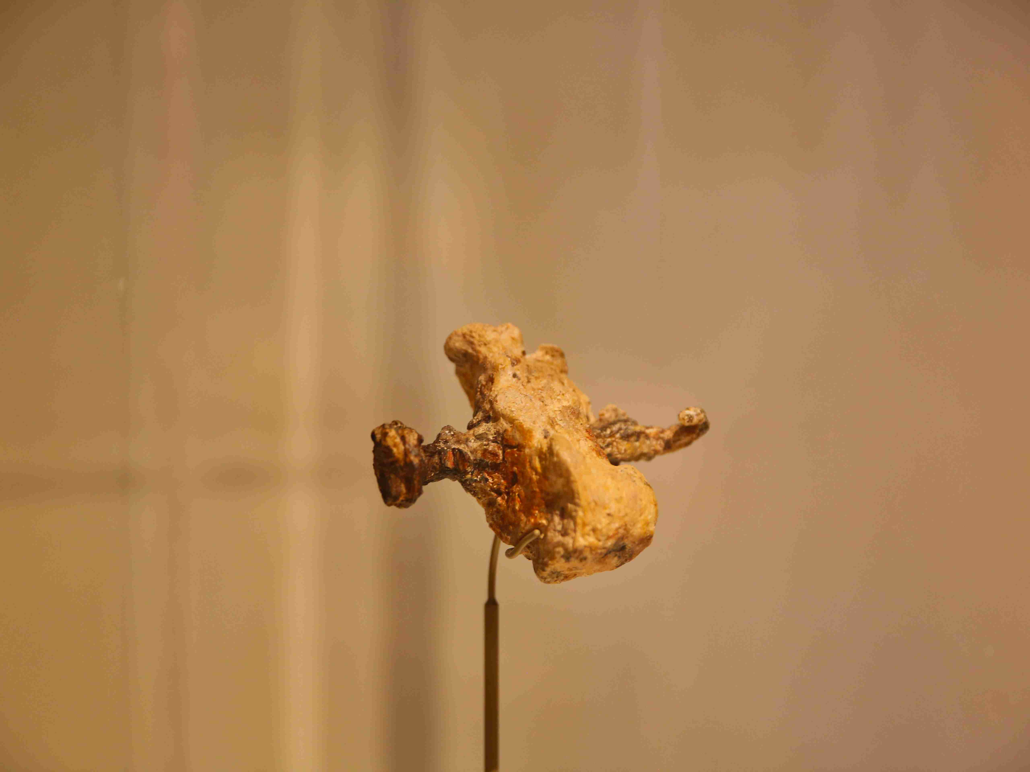
CDK

Slide 36
After the Crucifixion
Tetelestai- “It is finished."
  In the Greek it implies
    Something has come to an end
    It has been completed, perfected, accomplished in full
    The consequences that will endure on and on.
Temple Veil torn in two- Matthew 27:51; Luke 23:45

Slide 37
The Talmud (Yoma 39)
The rabbis taught: Forty years before the Temple was destroyed, the lot never came into the right hand, the red wool did not become white, the western light did not burn, and the gates of the Temple opened of themselves, till the time that R. Johanan b. Zakkai rebuked them, saying: "Temple, Temple, why alarmest thou us? We know that thou art destined to be destroyed. For of thee hath prophesied Zechariah ben Iddo [Zech. xi. 1]: 'Open thy doors, O Lebanon, and the fire shall eat thy cedars.‘”

Slide 38
Tombs
Matthew 27:60
  “New tomb hewn out of the rock”
  “Rolled a large stone against the door of the tomb”
John 20:12
  “Two angels in white sitting, one at the head and the other at the feet, where the body of Jesus had lain”

Slide 39
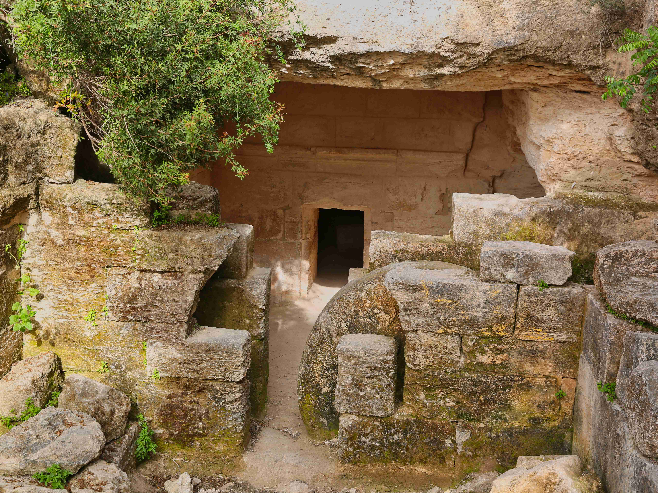
Khirbet Midras rolling stone tomb
CDK

Slide 40
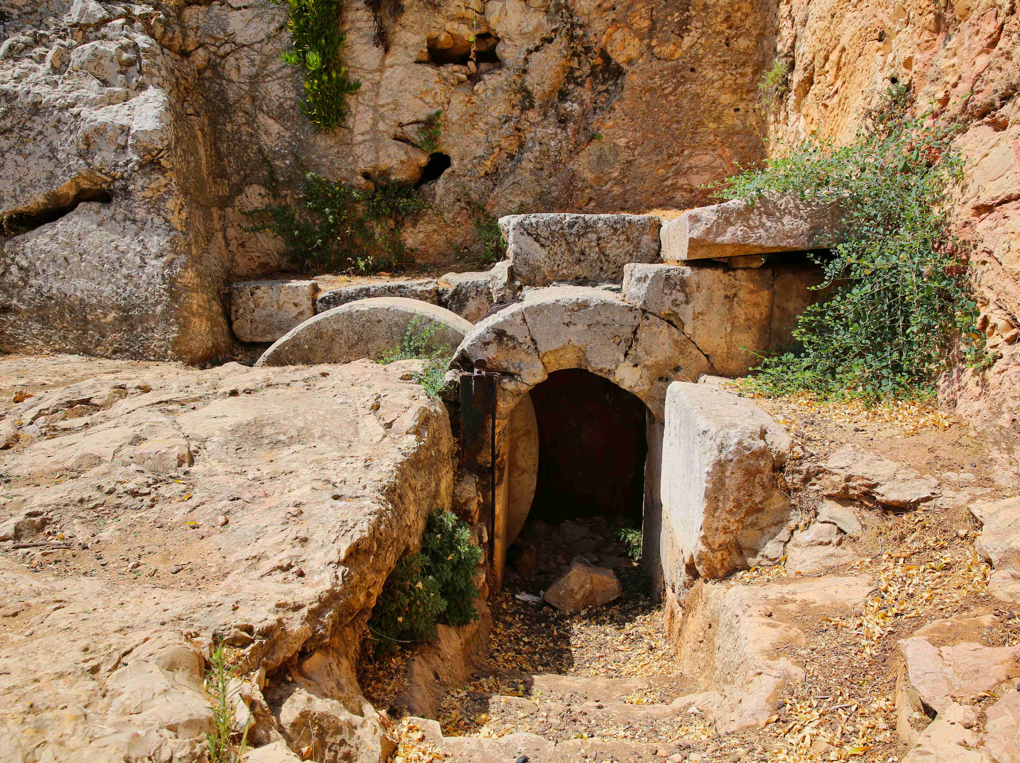
CDK

Slide 41
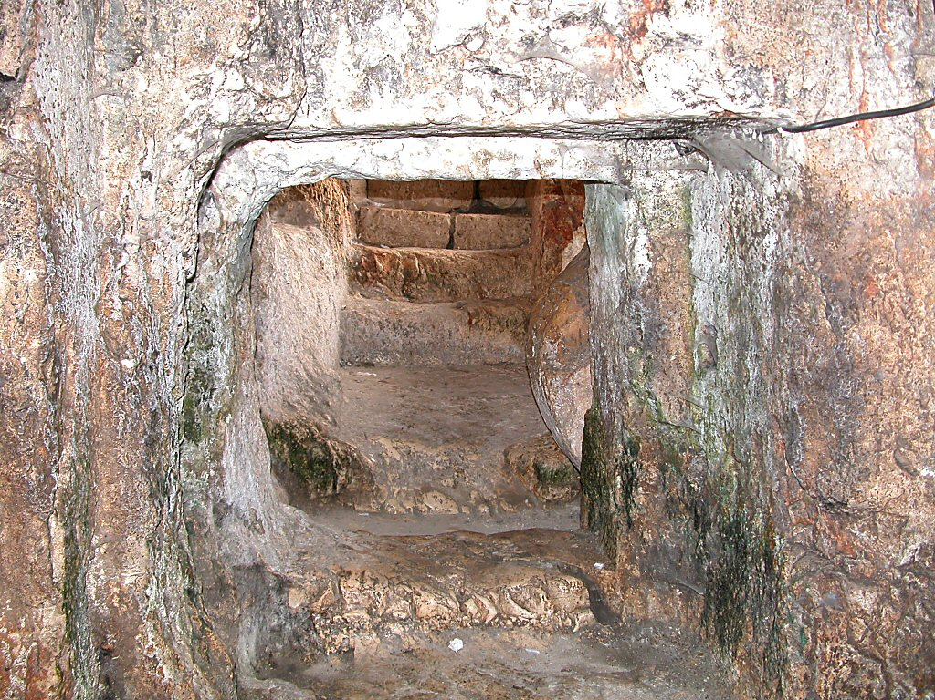
Tomb of the Kings entrance
Tomb of the Kings entrance
BiblePlaces.com

Slide 42
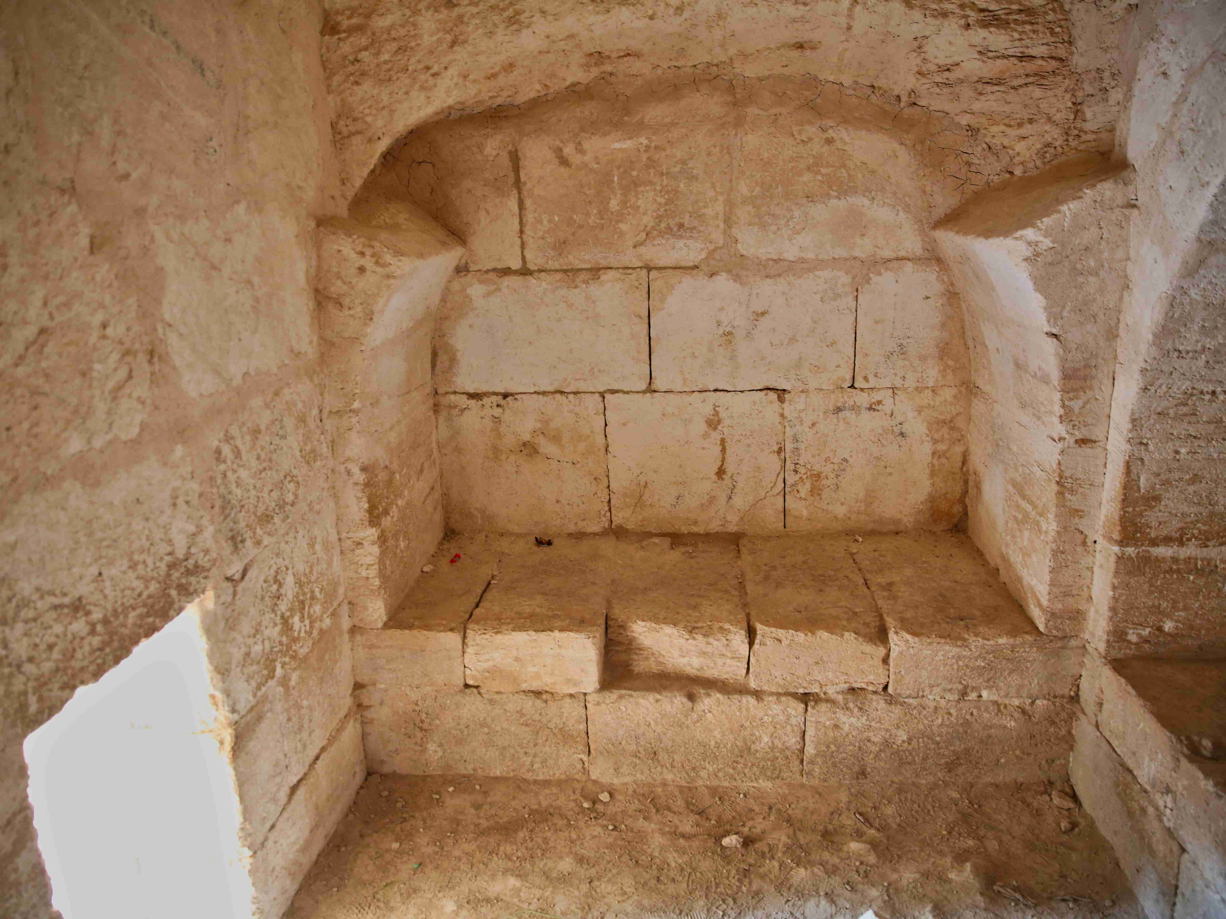
CDK
CDK

Slide 43
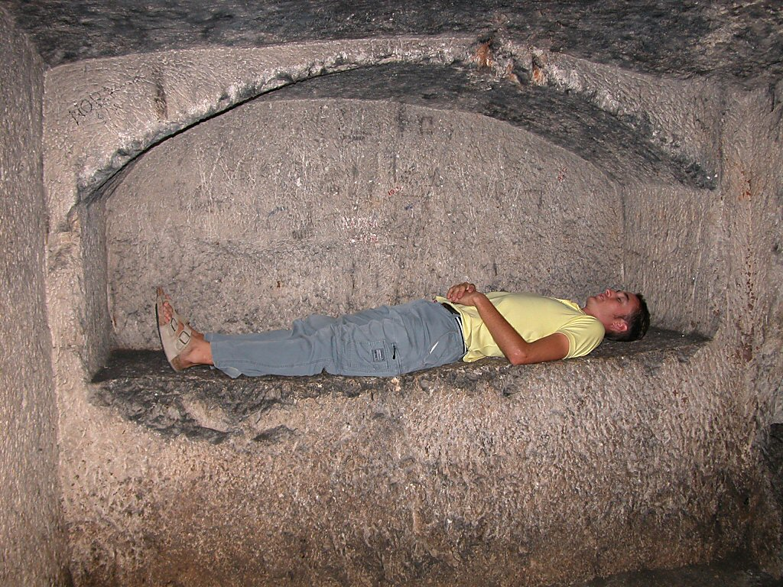
Tomb of the Kings arcosolium
Tomb of the Kings arcosolium
BiblePlaces.com

Slide 44
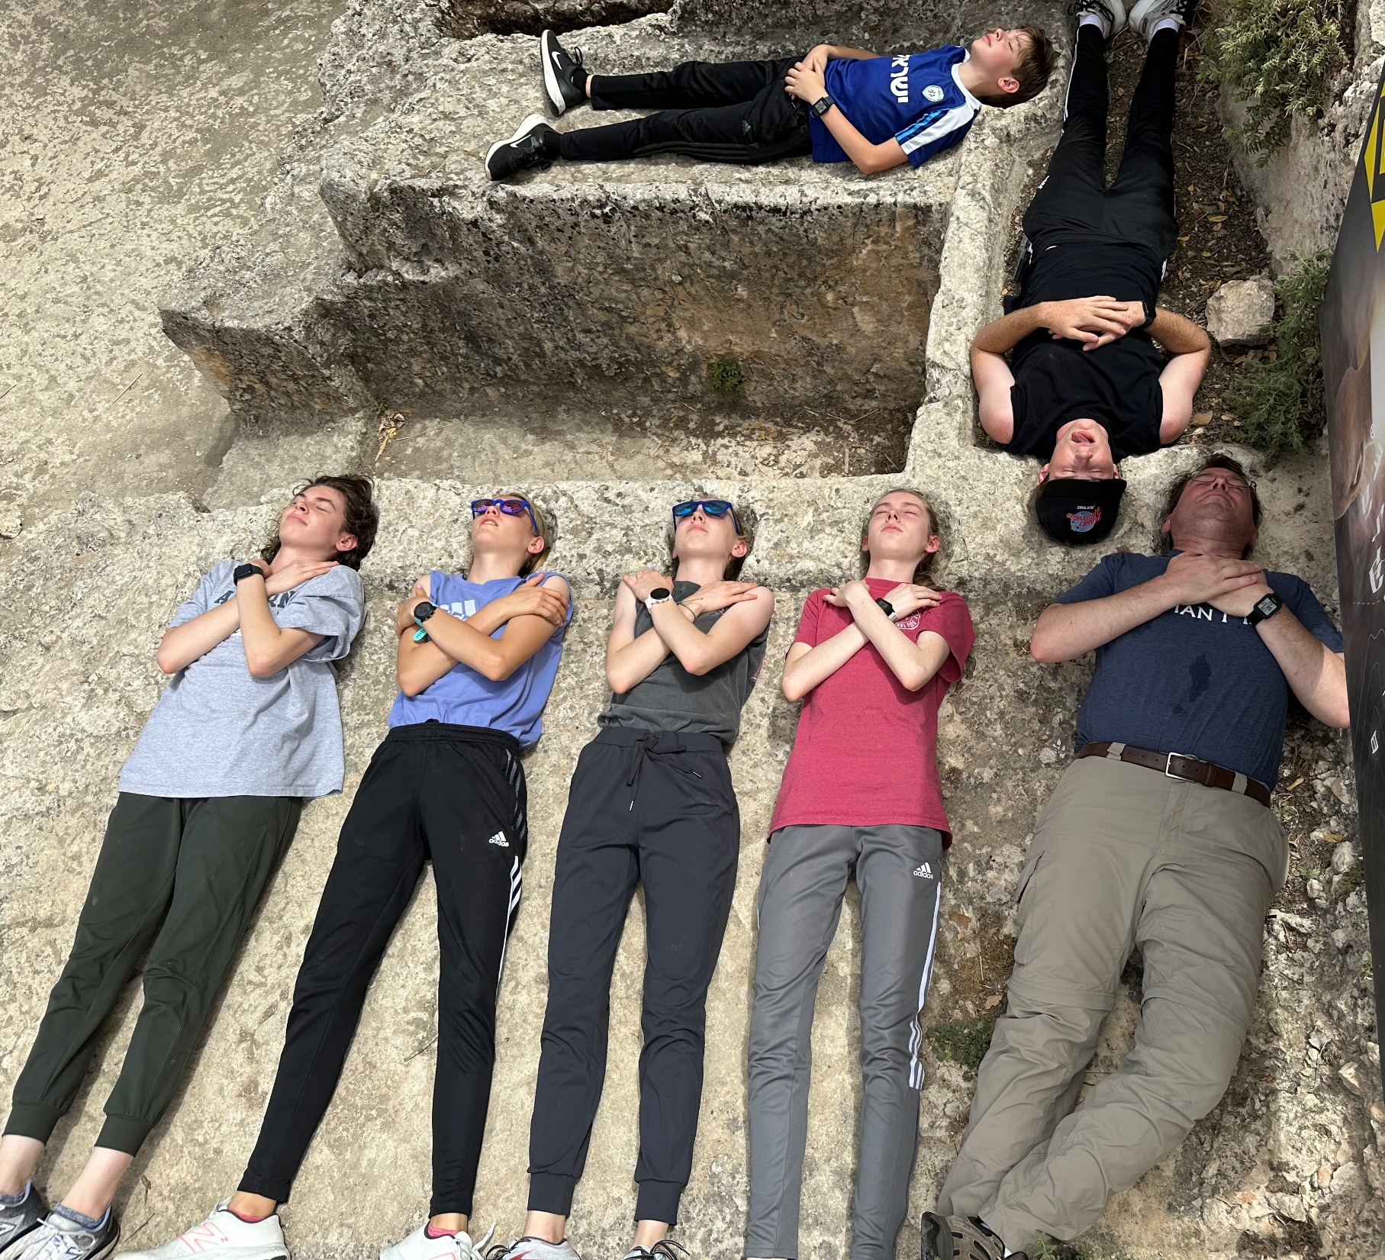
Ketef Hinnom tomb
Ketef Hinnom tomb
CDK

Slide 45
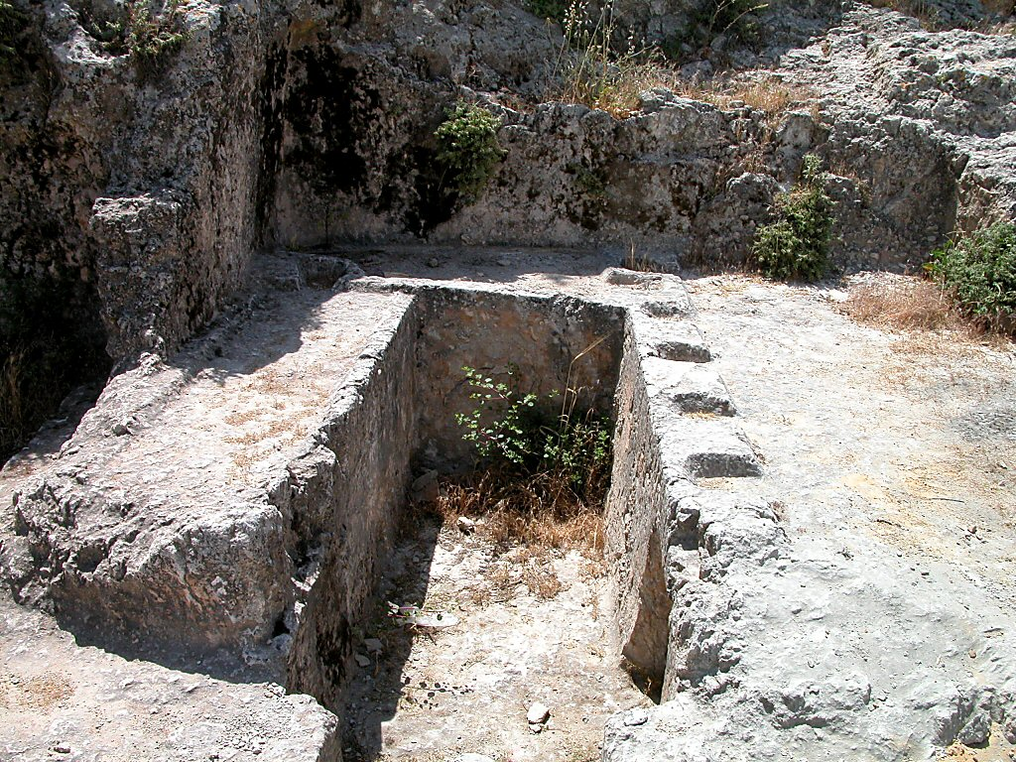
Ketef Hinnom tomb
Ketef Hinnom tomb
BiblePlaces.com

Slide 46
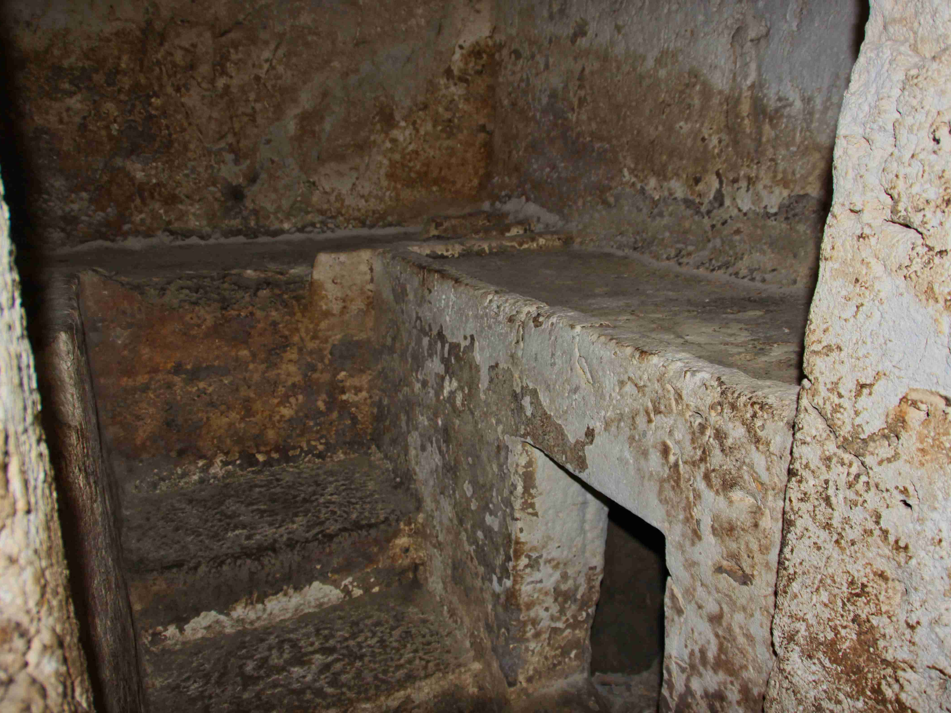
CDK

Slide 47
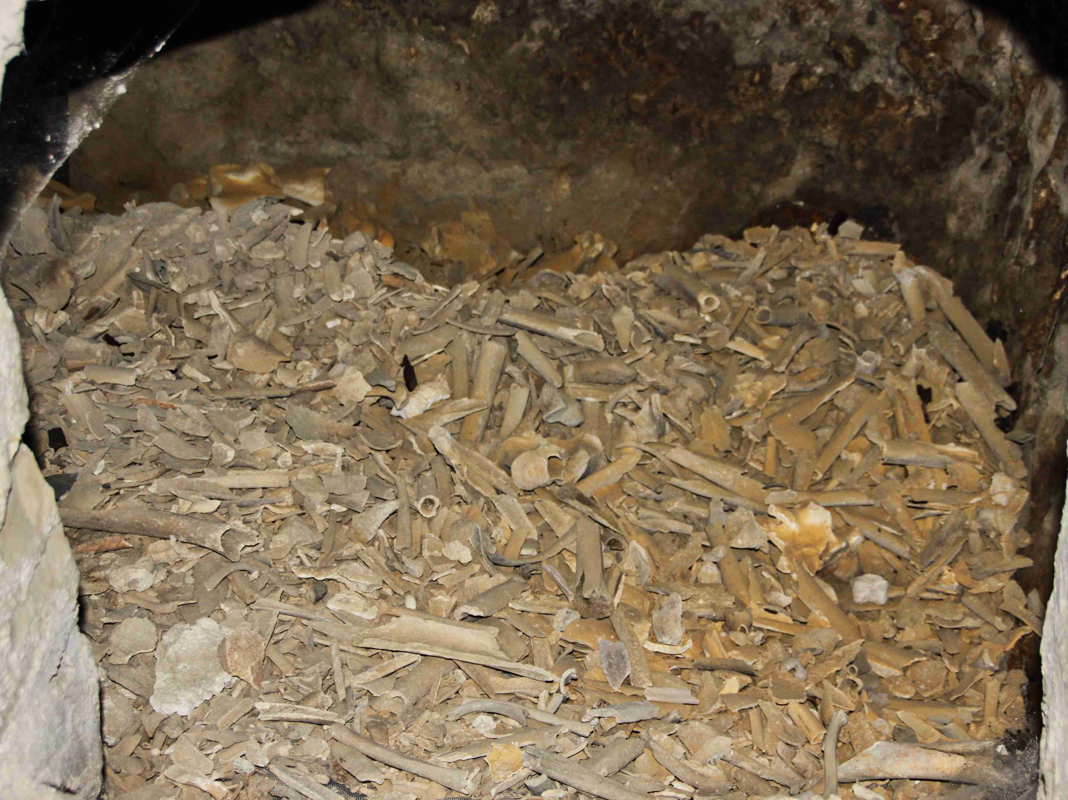
CDK
CDK

Slide 48
Empty Tomb
Credibility of the burial story
  2 members of the Sanhedrin bury (John 19:38-42)
  Paul’s emphasis (1 Corinthians 15:3-5)
Jerusalem factor- In enemy territory
4 Gospels agree
Enemy attestation- Earliest Jewish polemic- disciples stole the body (Matthew 28:11-15)
Guard left, but gravecloths remained
Testimony of women- Not regarded as reliable witnesses by Rome or Jews

Slide 49
Women’s Testimony
Josephus
  “But let not the testimony of women be admitted, on account of the levity and boldness of their sex… since it is probable that they may not speak truth, either out of hope of gain, or fear of punishment.”
Talmud
  “Any evidence which a woman gives is not valid to offer. This is equivalent to saying that one who is Rabbinically accounted a robber is qualified to given the same evidence as a women.

Slide 50
Early Belief That Jesus Arose From the Dead
Paul Testified in 1 Corinthians 15
Oral tradition
Written tradition
  4 Gospels
  Early apostolic fathers
    Clement of Rome
    Polycarp
    Etc.

Slide 51
Early Belief That Jesus Arose From the Dead
Skeptical
  Luke 24:5-12
  John 20:9, 24-28
50 days from cowardice (Mark 14:50) to courage (Acts 4:8-12, 18-20)
No personal benefit- endured persecution and martyrdom
  1 Corinthians 4:9-13

Slide 52
James’ Conversion
Brother of the lord- Galatians 1:19
Initially skeptic- Mark 3:21; 6:3-4, John 7:5
Disciple, teacher and leader in Jerusalem- Acts 15:13-21, Galatians 2:12-13
Died as a martyr

Slide 53
Saul’s Conversion
He was a leading persecutor- Acts 8:1-3; 9:1
Changed after personal encounter with Jesus- Acts 9, 22, 26
Important facts
  Not a believer already, who claimed a vision
  He did not have precedent in such a vision
  He had no basis for belief in an individual resurrection
  He had no personal motive, yet every motive to NOT believe
  Rising star Philippians 3 to hated enemy Acts 23:12-15

Slide 54
Acts 5: 35-39
“Gamaliel, …said to them: ‘Men of Israel, take heed to yourselves what you intend to do regarding these men. ³⁶ For some time ago Theudas rose up, claiming to be somebody… He was slain, and all who obeyed him were scattered and came to nothing. ³⁷ After this man, Judas of Galilee…drew away many people after him. He also perished, and all who obeyed him were dispersed. ³⁸… if this plan or this work is of men, it will come to nothing; ³⁹ but if it is of God, you cannot overthrow it.”

Slide 55
Rise of Christianity
Sunday as day of worship
BC AD; BCE CE
Disciples had no resurrection theology, without precedent
Given views of crucifixion by Greeks/Jews, impossible for anyone to think this was heroic death
Against Jews-killed Messiah and Romans- Jesus only king not Caesar

Slide 56
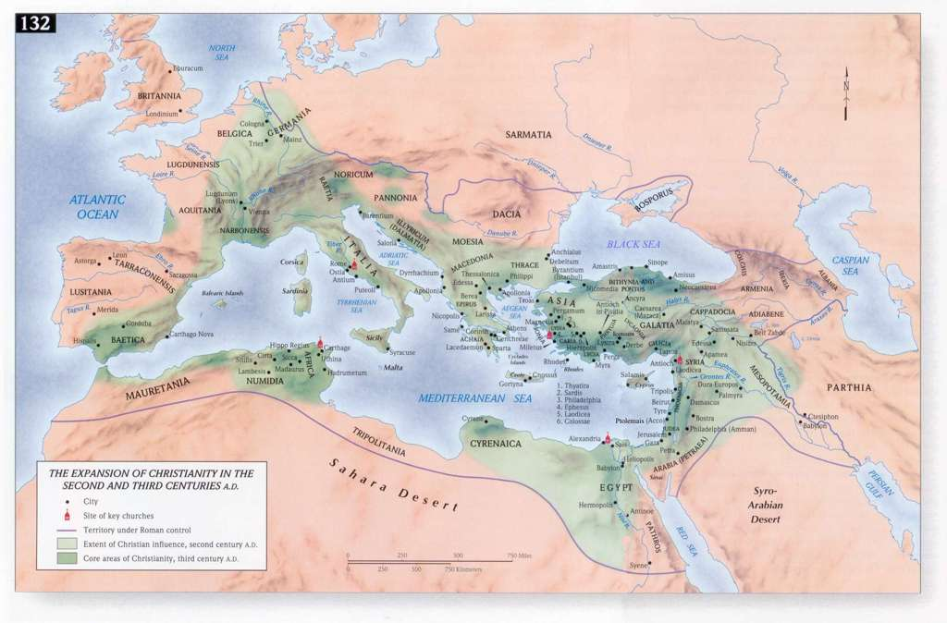
By AD 100, 64% of the port cities had churches in them
By AD 180, 86 % had churches in them.
The Bible Atlas, Access Foundation

Slide 57
C. S. Lewis
“I am trying here to prevent anyone saying the really foolish thing that people often say about Him: ‘I’m ready to accept Jesus as a great moral teacher, but I don’t accept His claim to be God.’ that is the one thing we must not say. A man who was merely a man and said the sort of things Jesus said would not be great moral teacher! He would either be a lunatic– on the level with the man who says he is a poached egg– or else he would be the Devil of Hell. You must make your choice. Either this man was, and is, the Son of God; or else a madman or something worse. You can shut Him up for a fool, you can spit at Him and kill Him as a demon; or you can fall at His feet and call Him Lord and God. But let us not come with any patronising nonsense about His being a great human teacher. He has not left that open to us. He did not intend to.

Slide 58
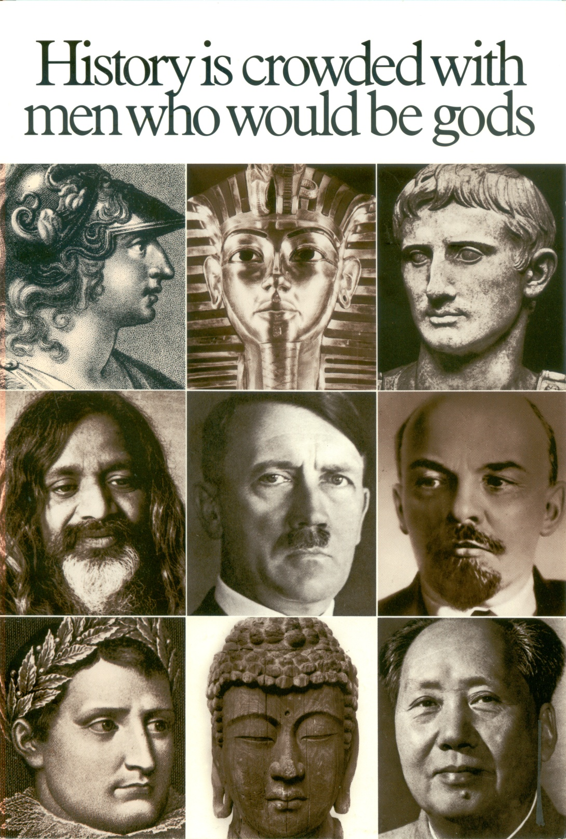
Ross Hunter

Slide 59
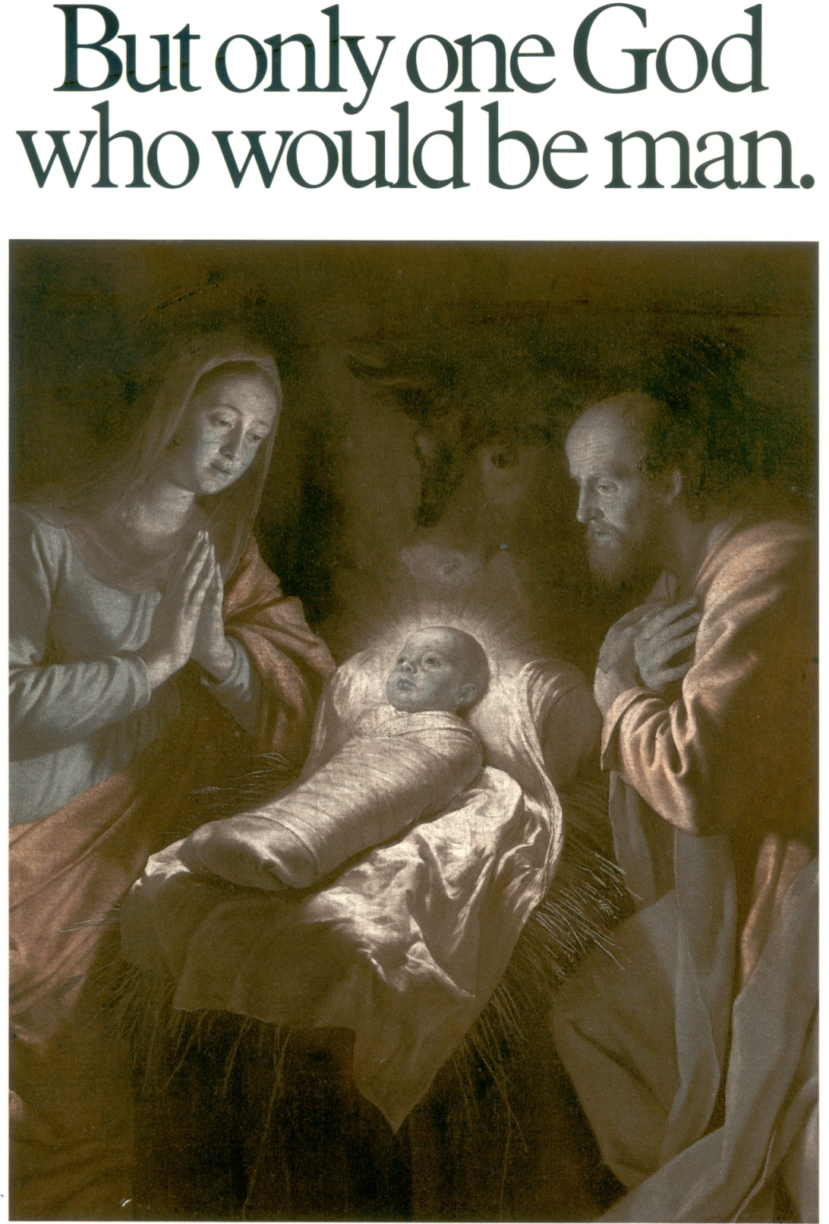
Ross Hunter

Slide 60
And yet Jesus was apparently only a carpenter from an obscure village in a despised nation. He never studied in a university, nor any other school so far as we know. He never traveled more than a few miles from His home, never wrote a book or article, never taught in a school. The only ones who paid much attention to what He taught (the multitudes sometimes listened and were impressed, but they soon forgot) were a motley band of unimpressive disciples, and even they missed the point on His most important teachings concerning His coming death and resurrection….

Slide 61
That such an obscure itinerant preacher would leave a legacy of the greatest teachings the world has ever known would seem absolutely impossible. But such is the fact! The only explanation that makes sense at all is that He was "a teacher come from God" (John 3:2), and that, as He claimed: "Whatsoever I speak therefore, even as the Father said unto me, so I speak" (John 12:50).
- Henry M Morris

