Slide 1
Apologetics-
God’s Footprints Around the World
Tri-Cities
December 8, 2024

Slide 2
Outline
Introduction
Existence of God/Evidence in Other Cultures
Natural Revelation
Natural Revelation- Medicine
Did Jesus Live
What did Jesus claim

Slide 3
Theme Text: Rom 1:20-23
“For since the creation of the world His invisible attributes, His eternal power and divine nature, have been clearly seen, being understood through what has been made so that they are without excuse.
For even though they knew God, they did not honor Him as God or give thanks, but they became futile in their speculations, and their foolish heart was darkened.

Slide 4
Professing to be wise, they became fools,
and exchanged the glory of the incorruptible God for an image in the form of corruptible man and of birds and four-footed animals and crawling creatures. ”
(NAS)

Slide 5
Polytheism vs. Monotheism
Anthropology tries to teach us monotheism evolved from polytheism
  Cesus (2nd Century Greek)
  Voltaire Essay (1780)
  Herbert Spencer Principles of Sociology (1877)
  Mark Smith, Re-reading Monotheistically: God in the Bible in Recent Literature (2001)
    Skirball Chair of Bible and Ancient Near Eastern Studies in the Department of Hebrew and Judaic Studies at New York University

Slide 6
Polytheism vs. Monotheism
Sir Flinders Petrie “Father of Modern Egyptology”
  “Were the conception of a god only an evolution from such spirit worship, we should find the worship of many gods preceding the worship of one god…. What we actually find is the contrary to this, monotheism is the first stage traceable in theology…”

Slide 7
Polytheism vs. Monotheism
Sir Wallis Budge another Egyptologist
  “As a result of their studies of Egyptian texts, many of the earlier Egyptologists, e.g. Champollion-Figeac, de Rouge, Pierret and Brugsch, came to the conclusion that the dwellers in the Nile Valley, from the earliest times, believed in the existence of one God, nameless, incomprehensible, and eternal."

Slide 8
Polytheism vs. Monotheism
Stephen Langdon- a professor of Assyriology
  “I may fail to carry conviction in concluding that in both Sumerian and Semitic religions, monotheism preceded polytheism…. The evidence and reasons for this conclusion, so contrary to accepted and current views, have been set down with care and with the perception of adverse criticism. It is, I trust, the conclusion of knowledge and not of audacious preconception...”

Slide 9
Common Ground
If ancient peoples had common beliefs in God, either:
  They evolved simultaneously
  They “borrowed” from each other
  They had a common ancestral knowledge
Has the God who created the gospel for all people, also prepared all people for the gospel?

Slide 10
The Chinese Language
Is the oldest, continuous written language in the world
First written over 4,500 years ago
The inventors of the written language drew pictures to express words or ideas
Simple pictures were combined to make more complex thoughts

Slide 11
Simple pictures were combined to make more complex thoughts
For Example…..
+
=
Mouth
Man (legs)
Older Brother
The “mouth man” or “spokes person” for the family was usually the oldest son or brother

Slide 12
Simple pictures were combined to make more complex thoughts
Well known history and
common everyday things were
used to make a word so people
could remember it
For Example…..
+
=
Mouth
Man (legs)
Older Brother
The “mouth man” or “spokes person” for the family was usually the oldest son or brother

Slide 13
Long before Buddha, the Chinese people worshipped the same God described in the Bible!!!!
The Proof is in the Ancient Chinese Characters

Slide 14
Long before Buddha, the Chinese people worshipped the same God described in the Bible!!!!
The Proof is in the Ancient Chinese Characters
2002 A.D.
2500 B.C.
1400 B.C.
600 B.C.
30 A.D.
Chinese language first written
Buddha
Death of Jesus
Today
First five books of Bible written

Slide 15
Long before Buddha, the Chinese people worshipped the same God described in the Bible!!!!
The Proof is in the Ancient Chinese Characters
2002 A.D.
2500 B.C.
600 B.C.
30 A.D.
Chinese language first written
Buddha
Death of Jesus
Today
“Shang Di” was the God of China before Buddha. He was the creator God and animal sacrifice was offered to him.

Slide 16
Long before Buddha, the Chinese people worshipped the same God described in the Bible!!!!
Shang Di
2002 A.D.
2500 B.C.
600 B.C.
30 A.D.
Chinese language first written
Buddha
Death of Jesus
Today
During the first three dynasties of China: Xia, Shang, Zhou, ……
the Chinese people worshiped Shang Di

Slide 17
Long before Buddha, the Chinese people worshipped the same God described in the Bible!!!!
Buddha
Shang Di
2002 A.D.
2500 B.C.
600 B.C.
30 A.D.
Chinese language first written
Buddha
Death of Jesus
Today
Worship of Buddha came to China from India in about 50 B.C.
The God of the Bible was re-introduced to China when foreigners came from Europe

Slide 18
Many in China today believe that the Bible is a Western book
They believe it is simply myth and fable written by western men
They think of it as an English book
HOWEVER!

Slide 19
The Bible is not a Western Book
The Bible was not written in English but in Hebrew and Greek
It’s first writers were from Egypt & Babylon (Iraq)
The first five books were written by Moses, an adopted son of the king of Egypt (1400 B.C.)
These five books focus on the beginning of the nation of Israel; but the first 11 chapters of the Bible records the history that all nations have in common

Slide 20
We will prove that the
ancestors of the modern Chinese
knew the same stories that are
in the first part of the Bible
We will now examine some stories in the Bible
Then
Show Chinese Characters which demonstrate the same story

Slide 21
How the Nations and Our Languages Became Divided
Now the whole earth used the same language and the same words. And it came about as they journeyed east, that they found a plain in the land of Shinar (Babylon) and settled there. And they said to one another, "Come, let us make bricks and burn them thoroughly." And they used brick for stone, and they used tar for mortar. And they said, "Come, let us build for ourselves a city, and a tower whose top will reach into heaven, and let us make for ourselves a name; lest we be scattered abroad over the face of the whole earth.“ (Continued)

Slide 22
How the Nations and Our Languages Became Divided
And the LORD came down to see the city and the tower which the sons of men had built. And the LORD said, "Behold, they are one people, and they all have the same language. And this is what they began to do, and now nothing which they purpose to do will be impossible for them. "Come, let Us go down and there confuse their language, that they may not understand one another's speech." So the LORD scattered them abroad from there over the face of the whole earth; and they stopped building the city. Therefore its name was called Babel, because there the LORD confused the language of the whole earth; and from there the LORD scattered them abroad over the face of the whole earth. (Genesis 11:1-9 NASB)

Slide 23
Notice the main points of this story in the Bible
Took place 5000 years ago
World’s oldest written language (Chinese) is more that 4500 years old
Languages were divided
People were scattered

Slide 24
Location of the Tower of Babel
2500-3000 B.C.
Today it is Iraq

Slide 25
If the Bible is true, all nations migrated or moved from Babel

Slide 26
The Chinese would have migrated or walked from the west to China

Slide 27
The Chinese
walked from the
west after a
great division
To Migrate, to Move
+
+
=
+
Great
Division
West
Walk
Migrate

Slide 28
GOD CREATED
Then the LORD God formed man of dust from the ground, and breathed into his nostrils the breath of life; and man became a living being. (Genesis 2:7)

Slide 29
Then the LORD God CREATED man of dust from the ground, and breathed into his nostrils the breath of life; and man became a living being. (Genesis 2:7)
+
+
=
DUST BREATH ALIVE TO TALK
MOUTH
+
=
TO TALK WALKING TO CREATE

Slide 30
According to the Bible
The First Man was a Living Dust Man
+
+
=
ALIVE
DUST
MAN
FIRST
According to the Chinese language, 4500 years ago this was also believed in China

Slide 31
Happiness or Blessing
+
+
+
God
One
Man
Garden
In the beginning God and the man had close fellowship, this leads to true happiness!

Slide 32
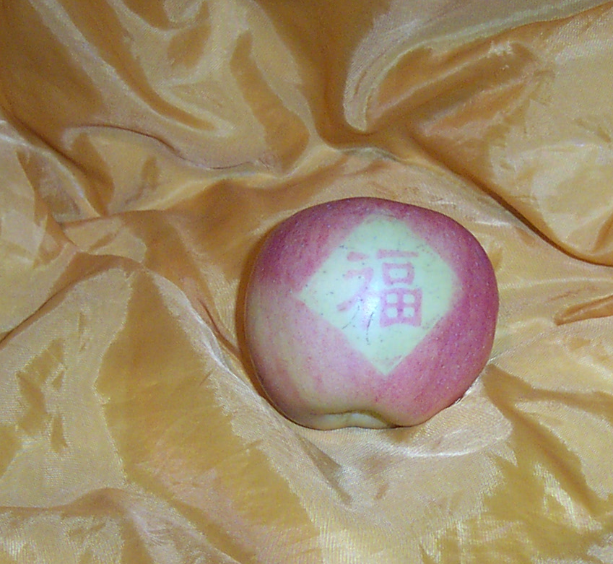
John McPherson

Slide 33
John McPherson

Slide 34
Garden of Eden
Eden was east for Moses
West
N
W
E
S

Slide 35
And God planted a garden eastward, in Eden; and there he put the man whom he had formed.
+
+
=
One, First
Person
Enclosure Garden
West

Slide 36
The First Man Needs a Woman
And the Lord God said, It is not good for the man to be by himself: I will make one like himself as a help to him And from the earth the Lord God made every beast of the field and every bird of the air, and took them to the man to see what names he would give them: and whatever name he gave to any living thing, that was its name. And the man gave names to all cattle and to the birds of the air and to every beast of the field; but Adam had no one like himself as a help. And the Lord God sent a deep sleep on the man, and took one of the bones from his side while he was sleeping, joining up the flesh again in its place: And the bone which the Lord God had taken from the man he made into a woman, and took her to the man. And the man said, This is now bone of my bone and flesh of my flesh: let her name be Woman because she was taken out of Man. For this cause will a man go away from his father and his mother and be joined to his wife; and they will be one flesh. (Genesis 2:18-24 BBE)

Slide 37
And God said, It is not good that the man should be alone; I will make him a helper suited for him. (Genesis 2:18)
+
=
West
Woman
To want, to desire, necessary
+
+
=
Man
Garden
One

Slide 38
And God said, It is not good that the man should be alone; I will make him a helper suited for him. (Genesis 2:18)
+
=
Two
People
Beginning, First

Slide 39
And the Lord God made a garden in the east, in Eden; and there he put the man whom he had made. And out of the earth the Lord made every tree to come, delighting the eye and good for food; and in the middle of the garden, the tree of life and the tree of the knowledge of good and evil. (Genesis 2:8-9 BBE)
How many special trees were in the middle of the garden?
TWO TREES

Slide 40
And the Lord God gave the man orders, saying, You may freely take of the fruit of every tree of the garden: But of the fruit of the tree of the knowledge of good and evil you may not take; for on the day when you take of it, death will certainly come to you. (Genesis 2:16-17 BBE)
Man was forbidden to eat one of the two trees -- if he ate the forbidden tree the other would be taken from him also.
+
=
Two Trees
Command
Forbidden

Slide 41
The Woman and the Forbidden Fruit
Now the snake was wiser than any beast of the field which the Lord God had made. And he said to the woman, Has God truly said that you may not take of the fruit of any tree in the garden? And the woman said, We may take of the fruit of the trees in the garden: But of the fruit of the tree in the middle of the garden, God has said, If you take of it or put your hands on it, death will come to you. And the snake said, Death will not certainly come to you: For God sees that on the day when you take of its fruit, your eyes will be open, and you will be as gods, having knowledge of good and evil. (Genesis 3:1-5)

Slide 42
The Woman and the Forbidden Fruit
When the woman saw that the tree was good for food, and that it was a delight to the eyes, and that the tree was desirable to make one wise, she took from its fruit and ate; and she gave also to her husband with her, and he ate. Then the eyes of both of them were opened, and they knew that they were naked; and they sewed fig leaves together and made themselves loin coverings. (Genesis 3:6-8 NASB)
+
=
Two Trees
Woman
To Covet, desire

Slide 43
The Chinese people 4500 years ago associated the devil with a garden and two trees
+
+
+
=
Life or Motion
Secret, private
Garden
Man
Devil, Satan
=
+
+
Tempter
Devil
Two Trees
Cover

Slide 44
After eating the Fruit they realized they were naked
D
D

Slide 45
After eating the Fruit they realized they were naked

Slide 46
Genesis 3:6 … she took of the fruit thereof, and did eat; ...
Genesis 3:16 Unto the woman he said, I will greatly multiply thy pain and thy conception; in pain thou shalt bring forth children; and thy desire shall be to thy husband, and he shall rule over thee.
+
=
A piece
Two Trees
Pain

Slide 47
Man’s Punishment with Weeds & Thorns
And to Adam he said, Because you gave ear to the voice of your wife and took of the fruit of the tree which I said you were not to take, the earth is cursed on your account; in pain (Sorrow) you will get your food from it all your life. Thorns and weeds will come up, and the plants of the field will be your food; With the hard work of your hands you will get your bread till you go back to the earth from which you were taken: for dust you are and to the dust you will go back. (Genesis 3:17-19 BBE)

Slide 48
GEN.3:17-19
+
=
ANCIENT WEEDS SORROW

Slide 49
FELLOWSHIP IS LOST
Man sins and has to leave the garden
SIN
GOD
MAN
Man’s guilt separates him from God

Slide 50
Righteousness or “Not Guilty”

Slide 51
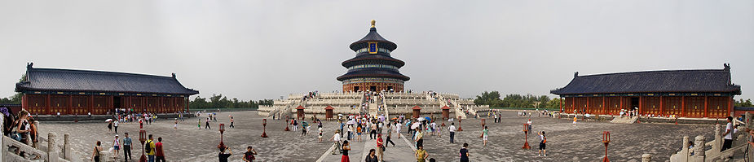
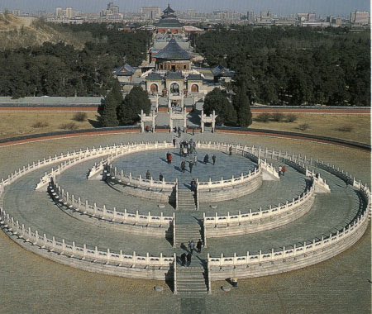
Maros Mraz
www.Beijing-Tours.cn

Slide 52
And the Lord said, Truly, if Cain is put to death, seven lives will be taken for his. And the Lord put a mark on Cain so that no one might put him to death. (Genesis 4:15)
The First Older Brother
in the Bible was violent.
The words for “elder son”
and “violent” are both
pronounced “SHUN”
+
=
MOUTH MAN ELDEST SON
Cruel,Violent

Slide 53
The Great World Flood
Noah, his wife, three sons, and their wives
Eight people on
the boat
And the earth was evil in God's eyes and full of violent ways. And God, looking on the earth, saw that it was evil: .…And God said to Noah, The end of all flesh has come; ….and now I will put an end to them with the earth. Make for yourself an ark of gopher wood with rooms in it, and make it safe from the water inside and out. …..For truly, I will send a great flood of waters over the earth, …everything on the earth will come to an end. But with you I will make an agreement; and you will come into the ark, you and your sons and your wife and your sons' wives with you. (Genesis 6:11-18 BBE)

Slide 54
GEN.6:5-8; 7:7
+
+
=
Person
Eight
Boat
Large Ship

Slide 55
+
+
=
Person
Large Ship
Eight
Boat
How did the ancient people
of China know these things?
They did not have a Bible!
A

Slide 56
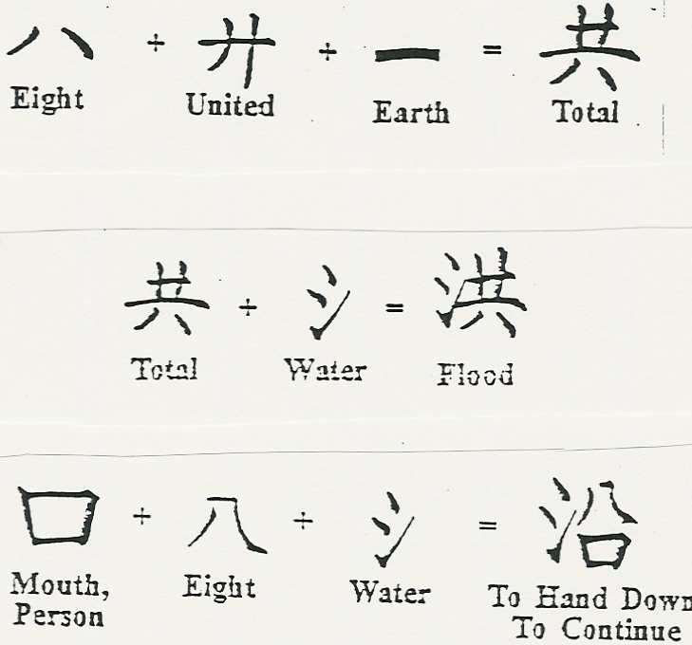
+
+
=
Person
Large Ship
Eight
Boat

Slide 57
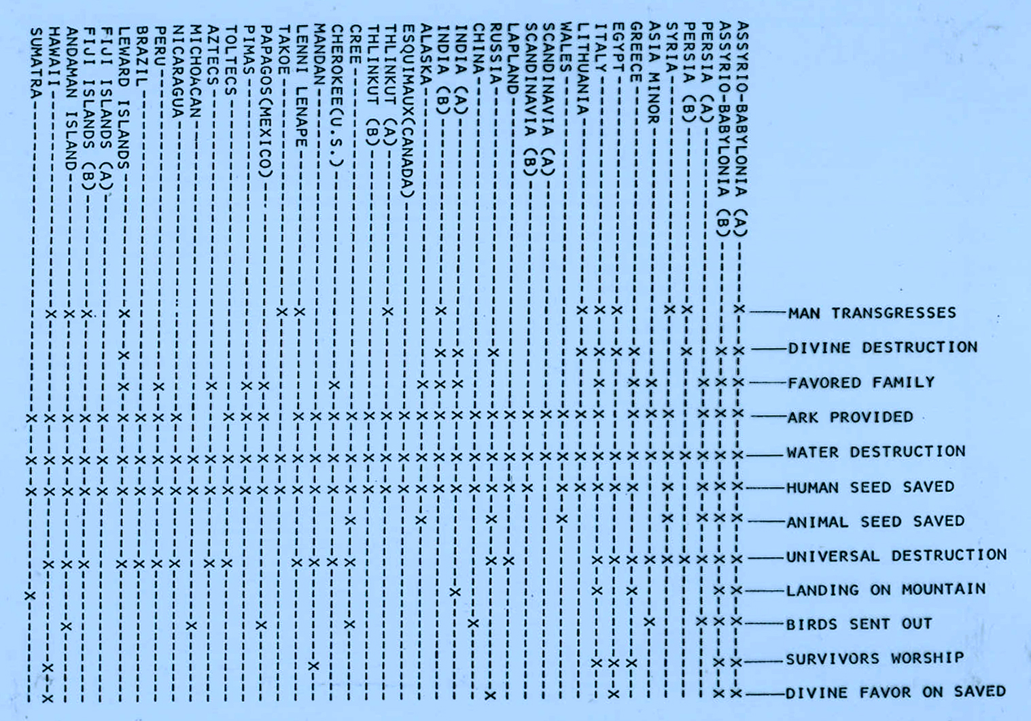
Gil Bremseth

Slide 58
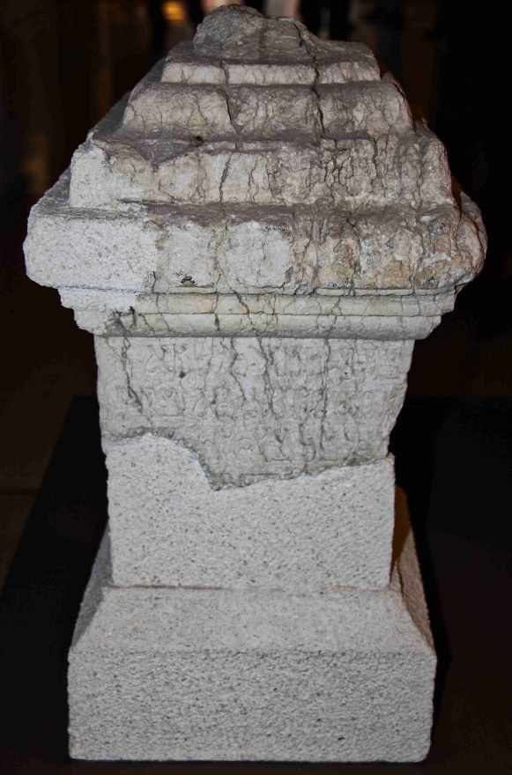
Greeks
Altar to the Unknown God Acts 17:22-32
  Pausanias Description of Greece
  Philostratus Appolonius of Tyana
  Diogenes Laertius
  The Lives of Eminent Philosophers
    Also wrote about Epimenides
CDK

Slide 59
Greeks
Epimenides
  Cretan priest, healer, purifier and prophet
  Called “a prophet of their own” by Paul
    Titus 1:12
  Tradition/History
    Went to Athens @500 BC to advise on a plague
    Obtained black and white sheep to graze on Mars Hill
    Had men mark where they lay down
    Later prophesied about Persia’s failed attempt to conquer Greece

Slide 60
Southeast Asia’s lost book
Minority groups expected a lost book from the Supreme God to be brought
Karen
Kachin
Lahu
Wa
Kui
Lisu
Naga
Mizo
Shan
Palaung
Most responded to missionaries in the 1800 and early 1900’s

Slide 61
A Hymn of Burma’s Karen
"The omnipotent is Y'wa; him have we not believed.
Y'wa created men anciently;
He has a perfect knowledge of all things!
Y'wa created men at the beginning;
He knows all things to the present time!
O my children and grandchildren!
The earth is the treading place of the feet of Y'wa.
And heaven is the place where he sits.
He sees all things, and we are manifest to him."

Slide 62
Burma’s Karen
Story of Man’s Fall
Y'wa formed the world originally.
He appointed food and drink.
He appointed the "fruit of trial."
He gave detailed order.
Mu-kaw-lee deceived two persons.
He caused them to eat the fruit of the tree of trial.
They obeyed not; they believed not Y'wa ...
When they ate the fruit of trial,
They became subject to sickness, aging, and death ..."

Slide 63
The Santal (India)
Oral Tradition
  Thkur Jui (Genuine God)
    Created man/woman
    They made rice beer at the enticement of Lita
    Awoke, and realized they were naked
    Later mankind was corrupted and destroyed in a flood while a “holy pair” was saved in a cave
    After multiplication, people were divided
    Ancestors then found other gods and forgot Thkur Jui

Slide 64
The Mbaka (Central Africa)
Oral Tradition
  Koro (The Creator)
    He had sent his Son into the world to accomplish something wonderful for all mankind
    Forefathers turned from the truth
    Forgot what it was Koro’s son had accomplished
    Messengers would come to restore the knowledge
Tribal rites of passage
  Blood sacrifice for initiate
  Water immersion followed by several days of acting like a new born child

Slide 65
Pachacuti (Inca king)
1438-1471
Questioned Inti (sun god)
  Cannot be universal if, while giving light to some, he withholds it from others
  He cannot be perfect if he can never remain at ease, resting
  Nor can he be all-powerful when the smallest cloud may cover him
Returned the upper class to the worship of Viracocha (ancient, supreme, uncreated)

