Slide 1
Introduction to Apologetics
Tri-Cities
December 8, 2024

Slide 2
Outline
Introduction
Existence of God/Evidence in Other Cultures
Natural Revelation
Natural Revelation- Medicine
Did Jesus live
What did Jesus claim

Slide 3
The Bible Is Not
Star Wars

Slide 4
The Bible is Not
Science Book
Atlas
History Book
It is a Diary, a special Divine revelation
Accurate in other ways, but used the idioms of the day
4 corners of the earth- Revelation 7:1
Sun rising/setting- Ecclesiastes 1:5

Slide 5
How God reveals Himself
Natural Revelation
Psalm 19:1-6
Acts 17:22-31
Acts 14:15-17
Romans 1:18-20
Ecclesiastes 3:11

Slide 6
"If you think strongly enough, you will be forced by science to believe in God."
-- William Thompson (Lord Kelvin) 1824-1907,
English Physicist. Inventor of the Kelvin temperature scale.
"If the Universe is a universe of thought, then its creation must have been an act of thought. Indeed the finiteness of time and space almost compel us, of themselves, to picture the creation as an act of thought."
-- Sir James Jeans, 1877-1946,
English Astronomer & Physicist

Slide 7
“For myself, faith begins with the realization that a supreme intelligence brought the universe into being and created man. It is incontrovertible that where there is a plan there is intelligence – an orderly, unfolding universe testifies to this truth.”
-- Arthur Compton, 1887 – 1954
Nobel prize winner in Physics

Slide 8
How God reveals Himself
Special Revelation
Psalm 19:7-14
John 1:18
John 20:30,31
Isaiah 46:8-11
Isaiah 48:3

Slide 9
Science’s Impact on Christian Life
The Pace of Science and Technology is accelerating.
Vast majority of all discoveries and inventions ever made were made within the last century.
Vast majority of all scientists, mathematicians and engineers that ever lived are still alive today.
We live in a world dominated by science and technology. (Do you really understand how your TV works? Or your microwave oven? Or the Internet?)
What does this mean for a person’s relationship to God?
Can one believe in the God of the Bible and reconcile that belief with scientific findings that are difficult for the rational mind to dismiss?

Slide 10
The Bible itself can help us discover the answer.
We need to consult the
two records
that provide insight into God.

Slide 11
The 1st Record: 2 Timothy 3:16-17
“All Scripture is inspired by God and profitable for teaching, for reproof, for correction, and for training in righteousness that the man of God may be complete, equipped for every good work.” (RSV)
i.e. God gave us the written Word so that we may be properly equipped for good works.
To be properly equipped, we must read and study about the nature of God and of Christ.
Study to show thyself approved unto God… 2 Tim 2:15 (KJV)

Slide 12
The 2nd Record: Romans 1:20
“For since the creation of the world His invisible attributes, His eternal power and divine nature, have been clearly seen, being understood through what has been made…” (NAS)
i.e. the nature of God can be understood by examining the Creation.
The process of examining the creation is called
Science.

Slide 13
These two records cannot Disagree! They came from the same source.
If they appear to disagree, one or the other isn’t being interpreted correctly.
Religious interpretations of the Bible are called:
doctrines.
Differing doctrines lead to denominations.
Scientific Interpretations of the natural world are called:
theories.
Some theories are more correct than others.

Slide 14
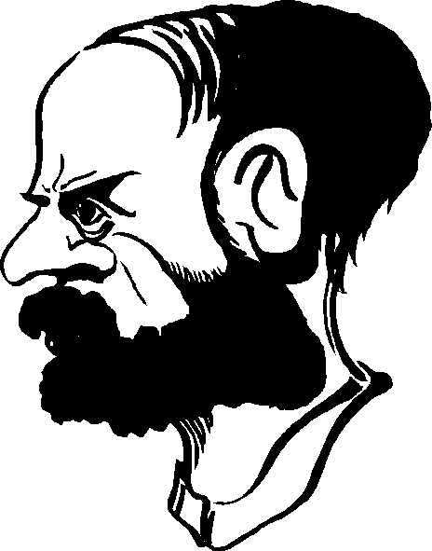
Some Christians
reject scientific
concepts as being
atheistic and evil.
Some Scientists reject
Christianity as being
superstitious, illogical
and dogmatic.
The so-called conflict between
Religion and Science
Is really between
Religionists
(Doctrine)
Scientists
(Theories)

Slide 15
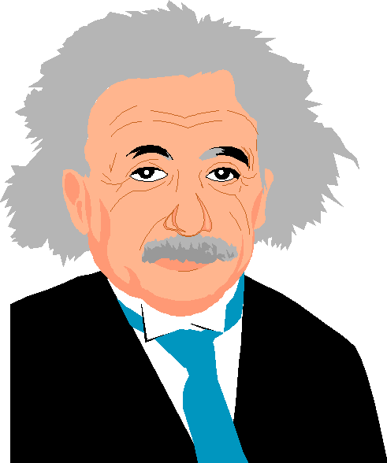
Science IS compatible with a living, creative, active God.
Science exists in a universe created by God and operates by the rules set in place by God.
Many scientists have come to
realize the truth.
"Science without religion is lame
and religion without science is blind."
-- Albert Einstein, 1879-1955,
Nobel Prize winner in Physics
ClipArt Gallery

Slide 16
For many, scientific knowledge allows them to rely on the logic of science and reject religion as unnecessary. This is a false sense of security since science cannot find a way to open the gates of eternity.
On the other hand, some Christians attribute to the Bible anti-science viewpoints that simply aren’t found in scripture. We must interpret the scriptures in proper context and without bias.

Slide 17
Apologetics
From the Greek- “Apologia”
Verbal defense, speech in defense
1 Peter 3:15
Phil 1:16
Used 8 times in the New Testament
Doubts Arise
In EVERYONE, none are peculiar to me/you
This is a tool for pre-evangelism

Slide 18
Apologetics
God warned about blind credulity
Mark 4:24, Luke 8:18, 1 Thess 5:21, 1 John 4:1
Not all evidence is good
The Lost day of Joshua found
The Nephilim found

Slide 19
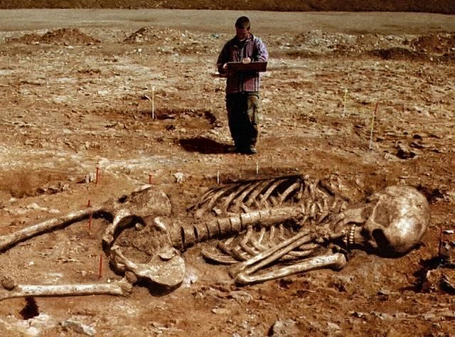
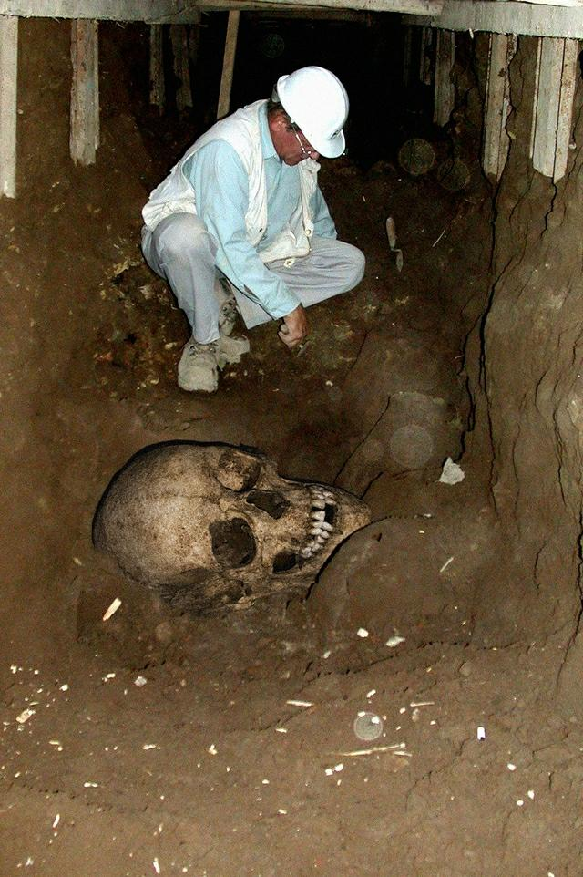
https://dougsarchaeology.wordpress.com/2011/10/25/archaeologists-find-giants-in-greece-oh-no-here-we-go/

Slide 20
Apologetics
God warned about blind credulity
Mark 4:24, Luke 8:18, 1 John 4:1, 1 Thess 5:21
Not all evidence is good
The Lost day of Joshua found
The Nephilim found
What if things change?
Where was the Red Sea Crossing

Slide 21
Library of Congress

Slide 22
What is Faith, from a worldly perspective
“Faith begins where reason ends”
“Faith means believing what you know can’t be true”
“Faith is believing in something when common sense tell you not to.”
“Unquestioning belief that does not require proof or evidence”
Marty Pickup, Overheads on Christian Evidences

Slide 23
Apologetics
God warned about blind credulity
Mark 4:24, Luke 8:18, 1 John 4:1, 1 Thess 5:21
Not all evidence is good
The Lost day of Joshua found
The Nephilim found
What if things change?
Where was the Red Sea Crossing
Christ was crucified on Thursday, not Friday
Age of the Earth

Slide 24
Apologetics
Testing claims- OK to question
Build faith
Answer the unbeliever
Not lose our young
“Reason and revelation are not opposed, nor reason and faith” – H.W. Everest

Slide 25
Accepting Evidence
Weight of evidence
Clarity of how the evidence is presented
Honesty of the examiner
Logical ability of the hearer to evaluate
Background and prejudice of the hearer

Slide 26
The Issue Is Not:
Scientific Fact vs. Religious Fact
The Issue Is:
Which Position of Faith Is More Reasonable Based on Your Interpretation of the Facts

Slide 27
Outline
Introduction
Existence of God/Evidence in Other Cultures
Natural Revelation
Natural Revelation- Medicine
Did Jesus live
What did Jesus claim

