Slide 1
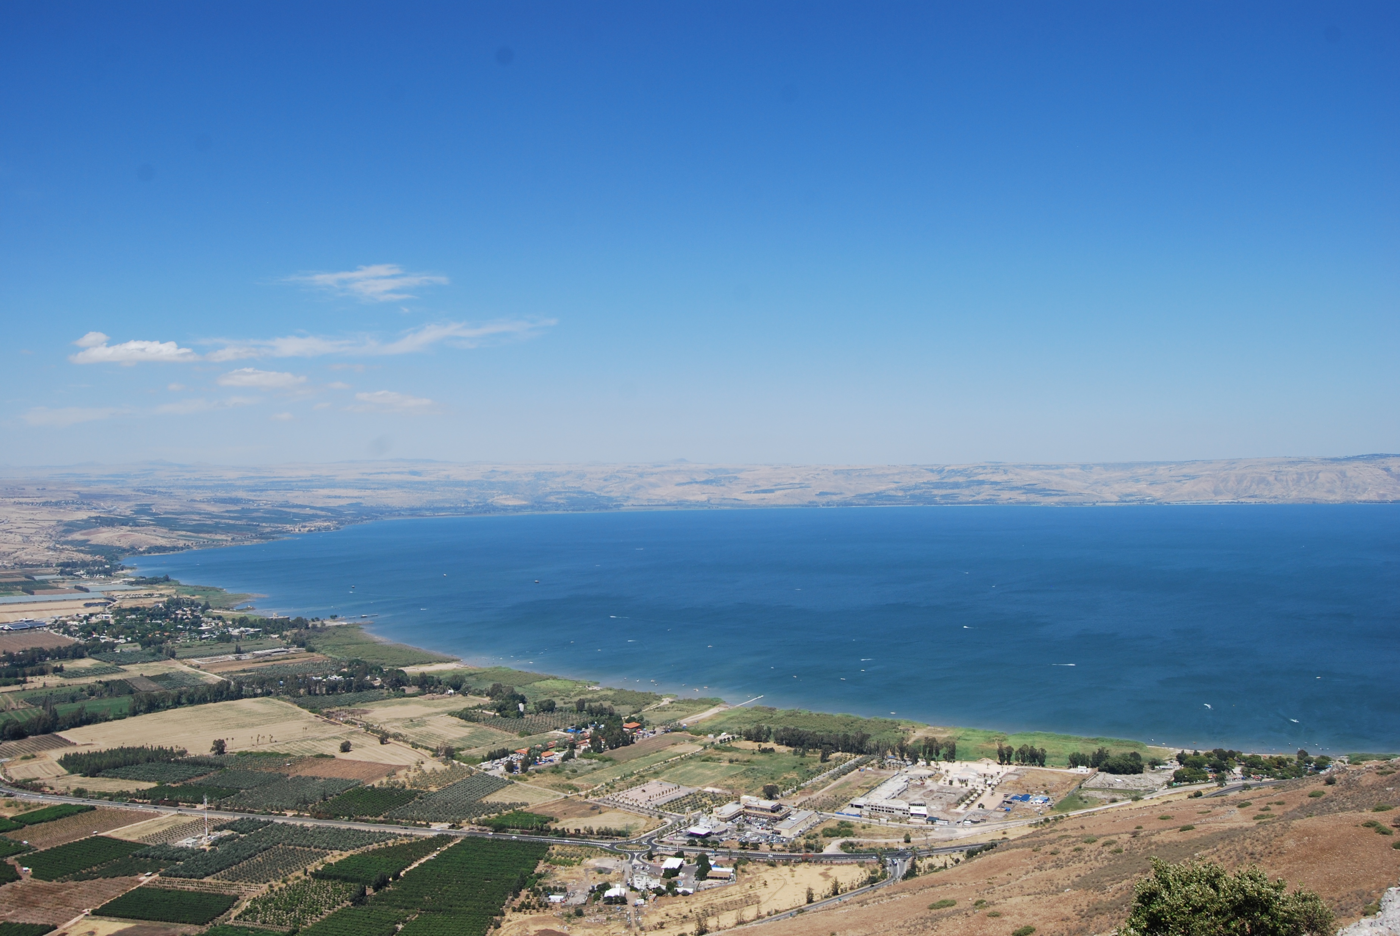
DEALING WITH EVIL INFLUENCES
Geographical Study of Judges 1

Slide 2
Genesis 12:1-3

Slide 3
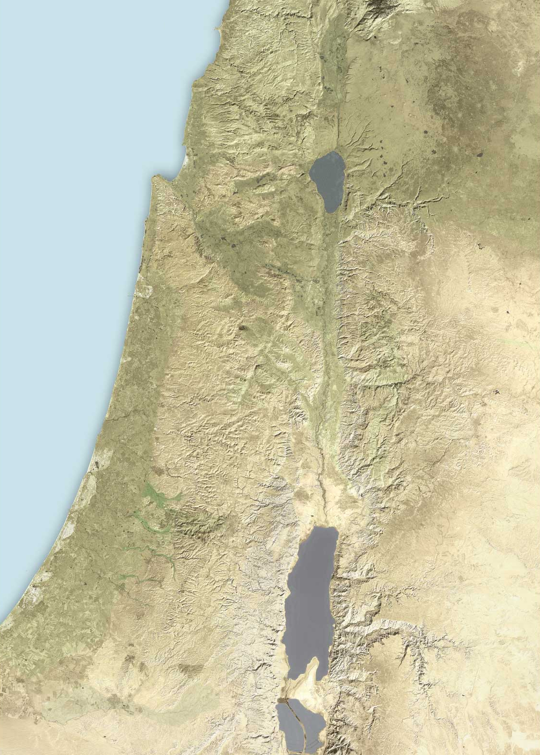

Slide 4
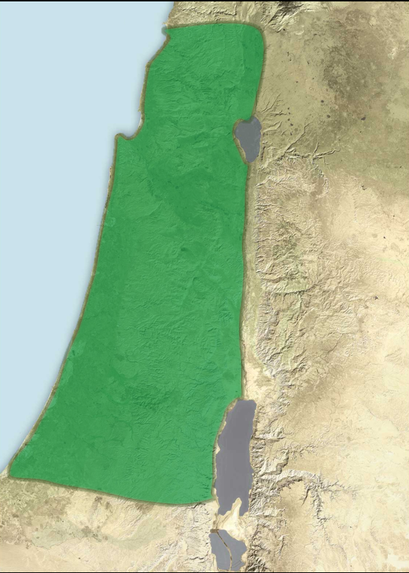

Slide 5
Judges 1

Slide 7
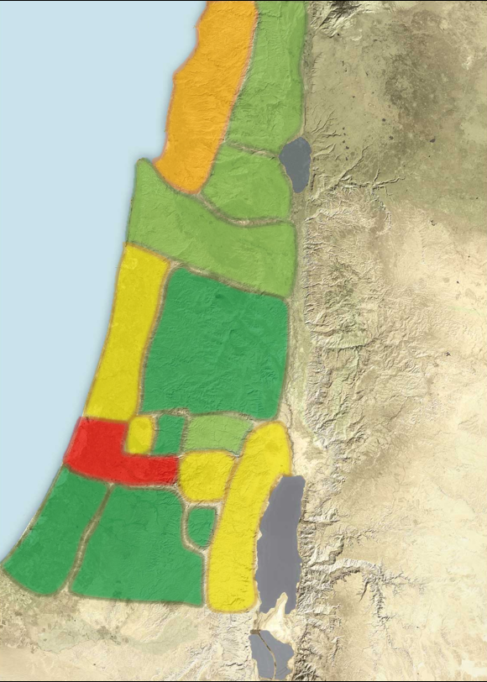

Slide 8
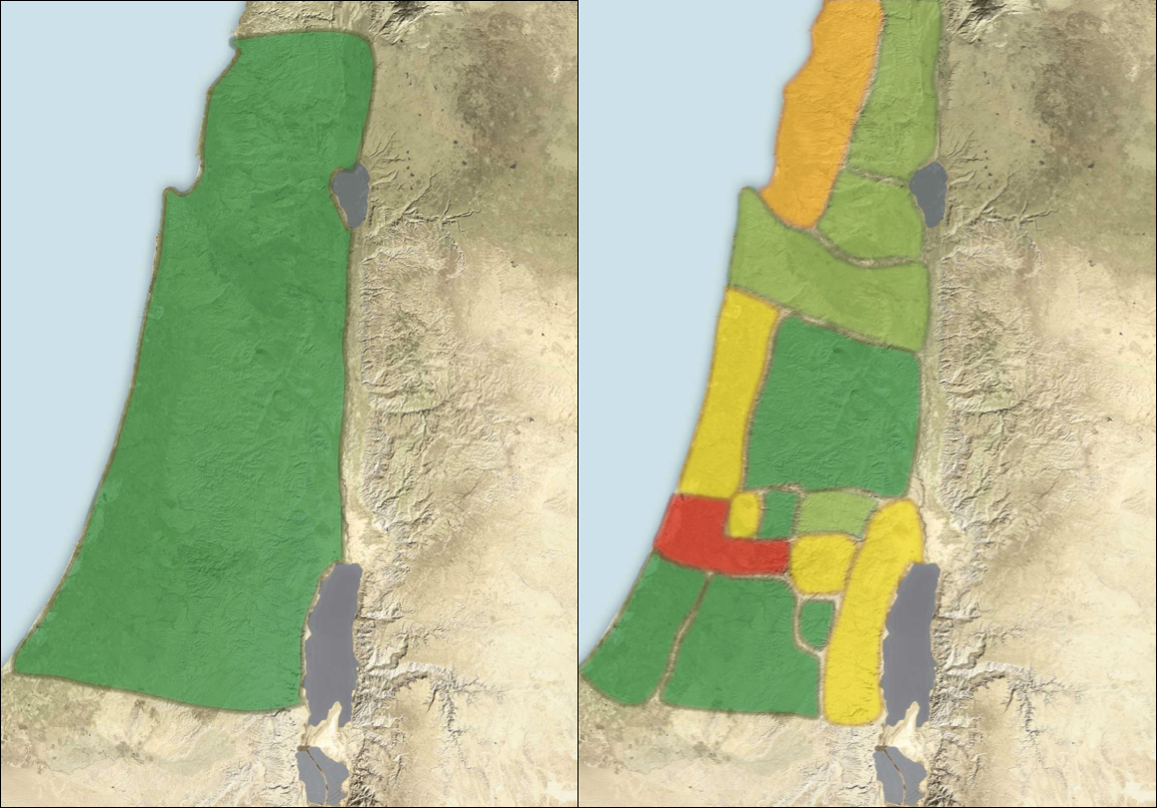
What God Wants….
What God Gets….

Slide 9
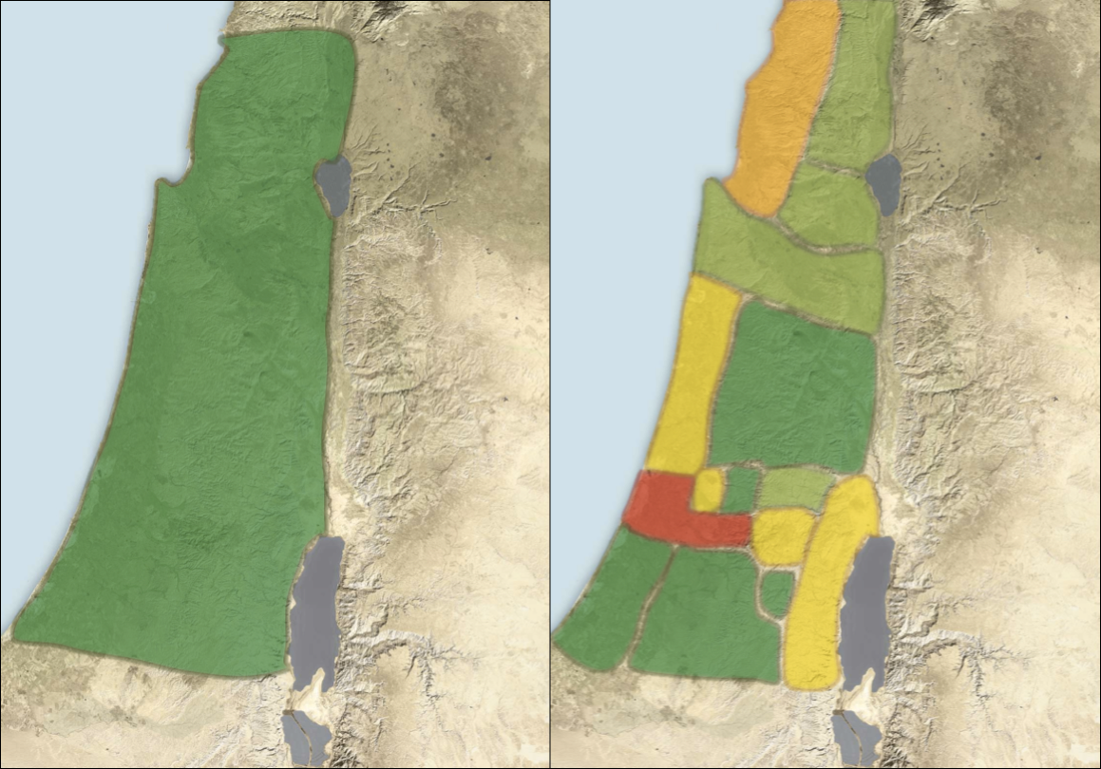

What God Wants….
What God Gets….

