Slide 1
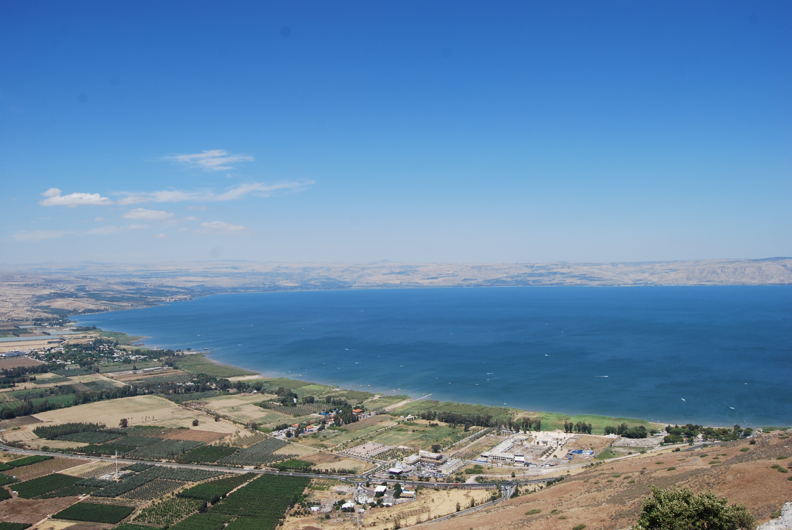
WALKING LIKE JESUS
Visual tour of the Land of Israel

Slide 2
Deuteronomy 6:4-9

Slide 3
1 John 2:4-6

Slide 4
Whoever says “I know him” but does not keep his commandments is a liar, and the truth is not in him, but whoever keeps his word, in him truly the love of God is perfected. By this we may know that we are in him: whoever says he abides in him ought to walk in the same way in which he walked.
1 John 2:4-6

Slide 6
Luke 2:41-51

Slide 7
jeffsimmons.org

Slide 8
Walking Like Jesus
Recognize that the purpose of your life is to serve God.
jeffsimmons.org

Slide 10
Matthew 4:18-22

Slide 12
Walking Like Jesus
Look for potential in others and get them involved.

Slide 14
Luke 4:16-31

Slide 17
Walking Like Jesus
Don’t let spiritual discouragement get you down.

Slide 19
John 4:1-15

Slide 23
Walking Like Jesus
Spend time with people who are different than you.

Slide 25
John 6:16-21

Slide 27
Walking Like Jesus
Try the impossible.

Slide 29
Luke 19:28

Slide 31
Walking Like Jesus
Make true sacrifices for others.

Slide 33
Walking like Jesus
Recognize the purpose of your life is to serve God.
Look for potential in others and get them involved.
Don’t let spiritual discouragement get you down.
Spend time with people who are different than you.
Try the impossible.
Make true sacrifices for others.

